Slide 1
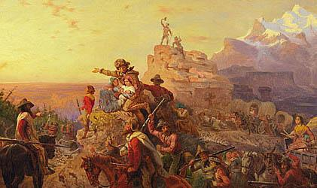
Westward! U.S. Expansion Westward

Slide 2
Down to Business
Essential Question
Why was President Jefferson's purchase of the Louisiana Territory controversial?

Slide 3
Why Do I Care,Miss McCormack?
Most people living in the Western United States today would not be members of this country if early Americans had not felt the need to grow and expand westward. Thomas Jefferson started our nation down this path.

Slide 4
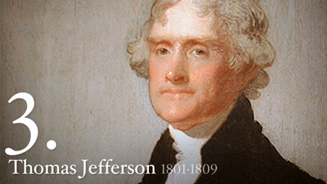
Election of 1800
after some election controversy Jefferson won by 2 votes.
Notes:
Slander, negative campaigning

Slide 5
Jefferson Shapes the Presidency
tried to decentralize the federal government by reducing costs
reduced the size of army/stopped growth of navy
reduced influence of National Bank of USA
eliminated internal taxes
encouraged free trade

Slide 6
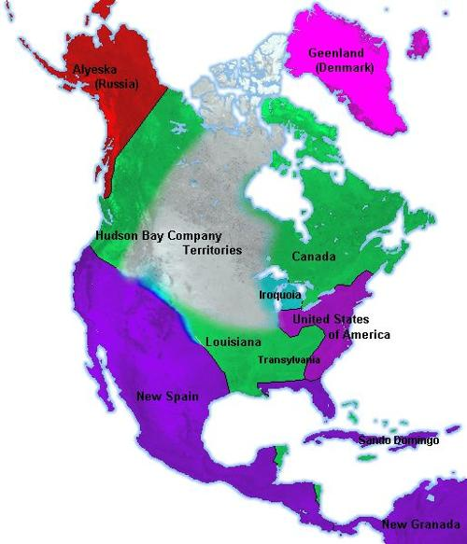
Americans Grow Restless
populations growing in all western territories
fear of French presence in the interior of the N. American continent

Slide 7
The Louisiana Purchase (1)
Jefferson negotiated with France for territory around Mississippi River
Proposed offer $10 million
Napoleon (leader of France) decided to sell the Louisiana Territory to U.S. in 1803 for $15 million
amount not approved by congress!
Notes:
Over $233 million

Slide 8
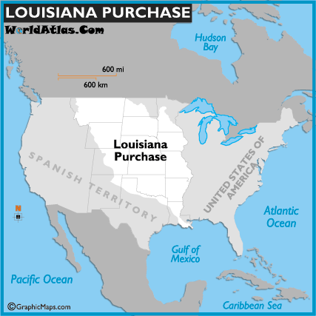

Slide 9
The Louisiana Purchase (2)
Jefferson was concerned that purchase was not within his powers as president (according to the Constitution)
but it was too late to undo the transaction.

Slide 10
4 Corners
The President should be allowed to make a big purchase using taxpayer money without consulting anyone else.
Decide if you Agree, Strongly Agree, Disagree, or Strongly Disagree.
Record your answer on the LEFT SIDE of your notebook

Slide 11
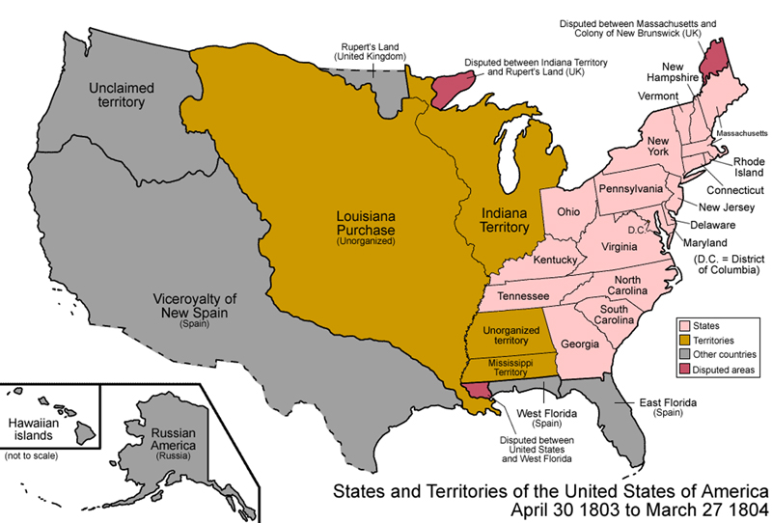
The Louisiana Purchase (3)
Louisiana Purchase doubled the size of the United States overnight

Slide 12
The Lewis and Clark Expedition (1)
Jefferson appointed Meriwether Lewis to lead the expedition
Lewis chose William Clark to be 2nd in command
Goals of expedition:
collect scientific info. about unknown plants & animals
learn as much as possible about Native Americans living in the territory

Slide 13
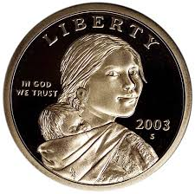
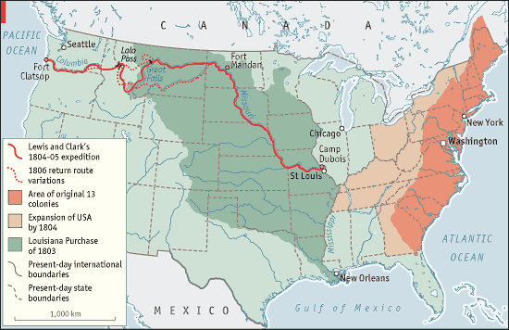
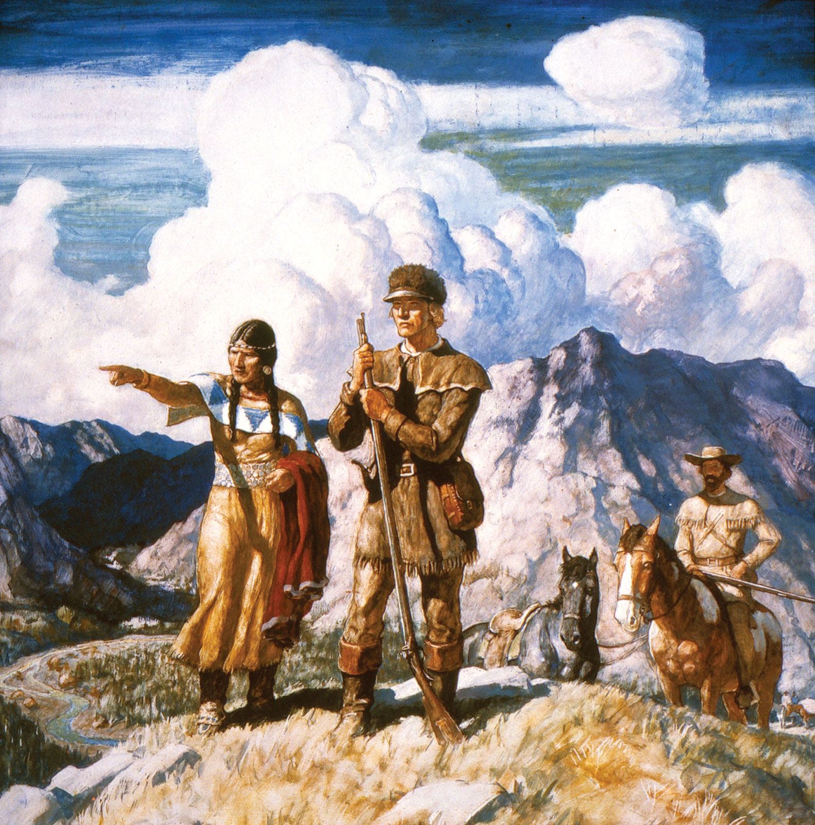
The Lewis and Clark Expedition (2)
50 soldiers & woodsmen
2 yrs 4 mo to complete expedition
Sacajawea joined the journey later and gave much needed help with:
communication
navigation

Slide 14
SUMMARY TIME

