Slide 1
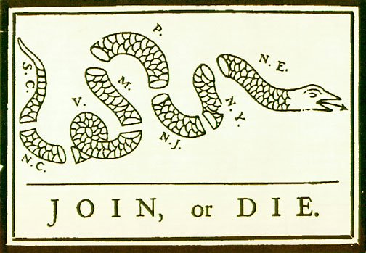
The War for Independence
Notes:
‹#›

Slide 2
Down to Business
Essential Question
Why is the Declaration of Independence such an important document?

Slide 3
Why do I care, Miss McCormack?
By the mid-1700’s American Colonists had declared their independence from Britain believing that there was no other way to solve their disagreements with the English government. As a result of this declaration a bloody war erupted between a fledgling nation and the most powerful empire in the world. Against all odd the American colonists fought for the formation of the United States of America. However, the war was only the beginning of a long battle to form a new nation.
Notes:
‹#›

Slide 4
Colonies Unite
First Continental Congress-1774
Every colony but Georgia sent representatives
Sent petition to king
Agreed to enforce boycotts
Each colony would set up militias
Meet following May if need be
Notes:
‹#›
Georgia agrees to decisions made
Petition said Parliament did not have the right to tax colonies

Slide 5
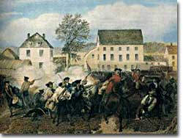
Lexington & Concord
Massachusetts militia ready
Minutemen
Collecting weapons and gunpowder
Britain had 7,000 troops in colonies
April 1775
British General Thomas Gage orders 700 soldiers to march to town of Concord
Colonist watched troop movement
Paul Revere warned the minutemen
Notes:
Minutemen: believed to be ready in a minute
General Gage heard that there were supplies at Concord
Paul Revere rode through the night

Slide 6
Lexington & Concord
70 minutemen assembled in town of Lexington
Shot rang out-8 minutemen dead
British continued on to Concord
Second skirmish
Colonists pushed the British back to Boston
By the time they reached Boston, nearly 300 dead
Notes:
Captain John Parker: Stand your ground, don’t fire unless fired upon, but if they mean a war, let it begin here.
Colonists made strong message they are willing to fight for their rights

Slide 7
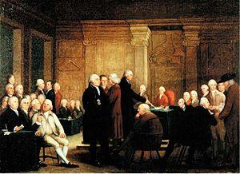
Continental Congress
Second Continental Congress- 1775
creation of the Continental Army
George Washington in charge
Independence proposed
Notes:
‹#›
Not everyone wants to break away from Britain
Richard Henry proposes Independence, put off voting until July

Slide 8
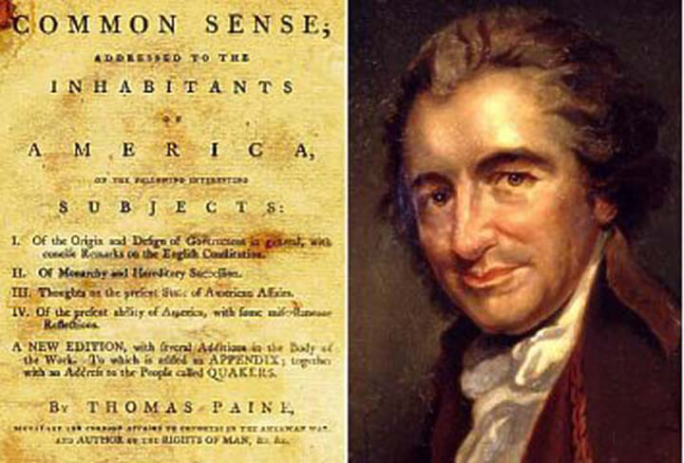
It’s…. Common Sense
Thomas Paine published a pamphlet
Common Sense
Argued that colonists break away from Britain government
Popular book
Turns fight for rights into fight for independence
Notes:
Paine recent immigrant from England
Independence the right thing
“The cause of America is in great measure the cause of all mankind”
Contiental Congress had read Common Sense

Slide 9
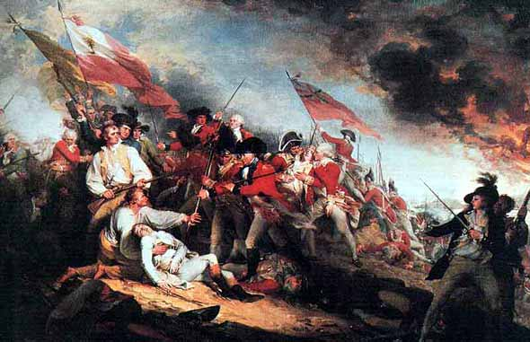
Battle Bunker Hill, MA
June 17, 1775
Britain attacked Bunker HIll, MA
British soldiers advanced uphill 3 times
Colonists continue fighting
Retreated when they ran out of gunpowder
900 British casualties
Proved that Colonists would fight

Slide 10
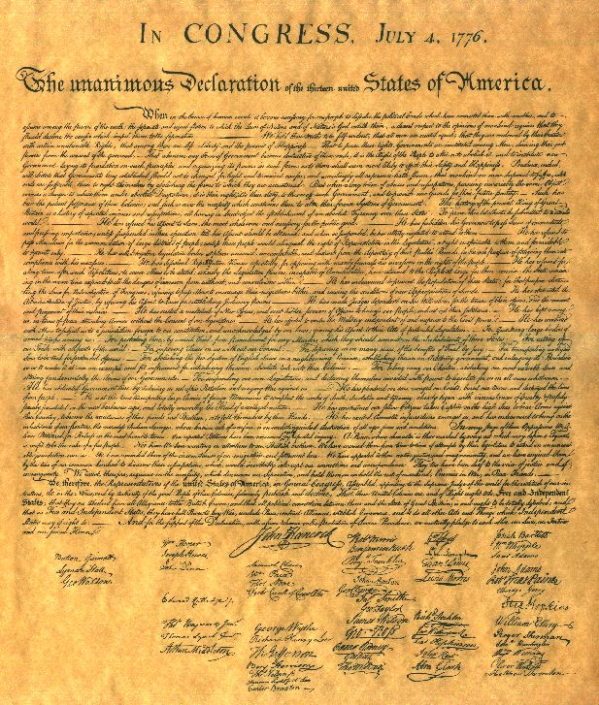
We tried to be nice…
Committee appointed to write statement declaring why independence was justified
Thomas Jefferson given the task

Slide 11
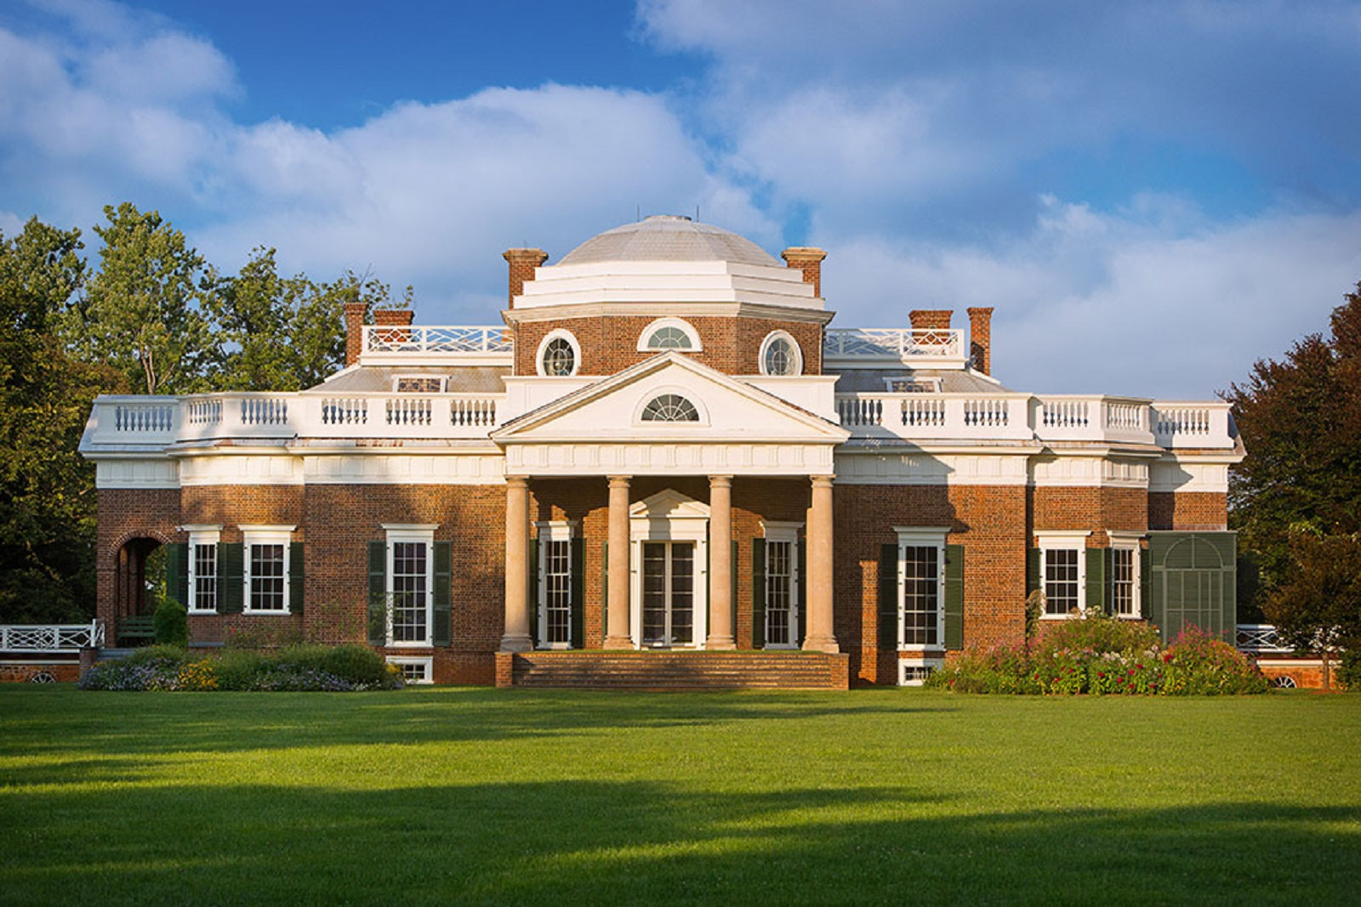
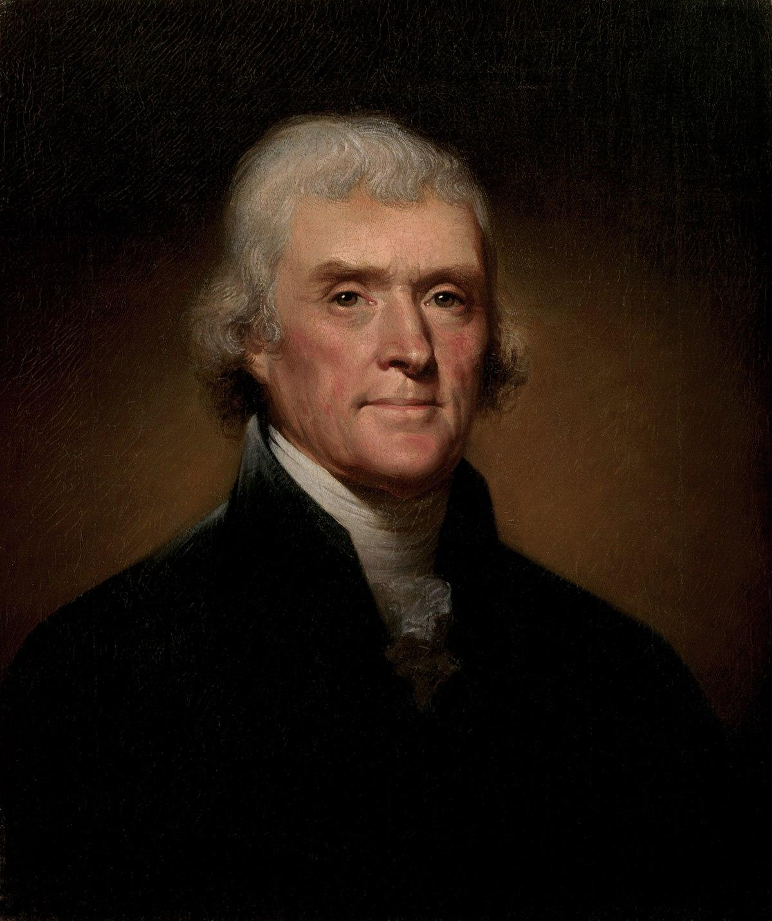
Thomas Jefferson
Virgian
Educated
Graduated from William and Mary College at 19
Lawyer
Inherited land
Built Monticello
Notes:
“During the most closely occupied daysof his college life, it was his habit to studyuntil two o’clock at night an rise at dawn.”

Slide 12
It’s too late to apologize...
Notes:
Read Break up letter before video

Slide 13
Summary Time

Slide 14
Revolutionary War
Notes:
‹#›

Slide 15
Down to Business
Essential Question
How did the Revolutionary War impact the colonies & the world?

Slide 16
Early Stages
Patriots
First year went well
Washington’s army pushed Britain out of Boston
British
isolate New England
naval control/blockade of the east coast
1778
shifted South
gain Loyalist support
Notes:
Thought rebellion wouldn’t last long
Lasted 8 yrs

Slide 17
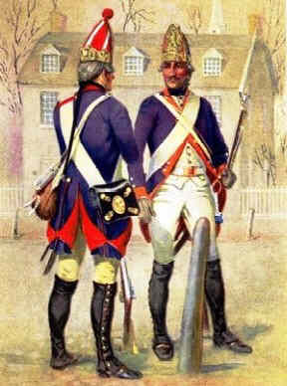
In this corner…..We have the BRITISH!
The British forces
Tough, well-trained, well-armed
British navy ruled the seas
Had more help from Natives
Had to hire mercenaries to fight
30,000 German Hessians

Slide 18
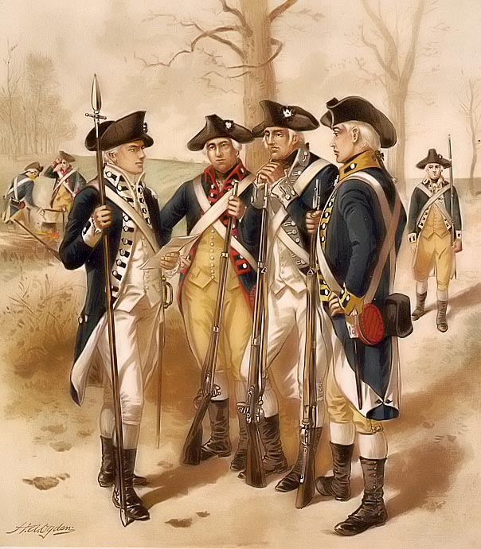
In this corner….We have the PATRIOTS!
The Patriot forces
Fighting for freedom
Fighting on own land
Size of colonies was advantage
Excellent leadership
Defensive war
Notes:
Home advantage, they know the landscape.

Slide 19
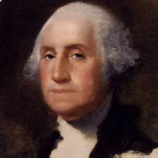
Players
George Washington
General of the Continental Army
Charles Cornwallis
General of the British Army

Slide 20
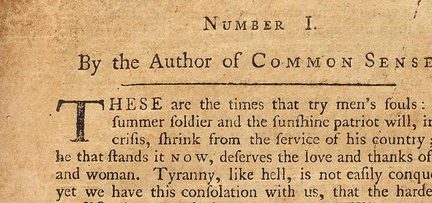
British Fight Back
War turned against the Patriots
Washington needed victory to boost morale
Reads Thomas Paine’s The Crisis
Notes:
British took New York, Americans became discouraged and started to desert

Slide 21
Battle of Trenton, NJ
December 1776
Washington crossed the Delaware River
captured almost 1,000 British troops
Notes:
Washington needed a victory, so he devised a plan that had his army cross in New Jersey to battle the Hessians.

Slide 22
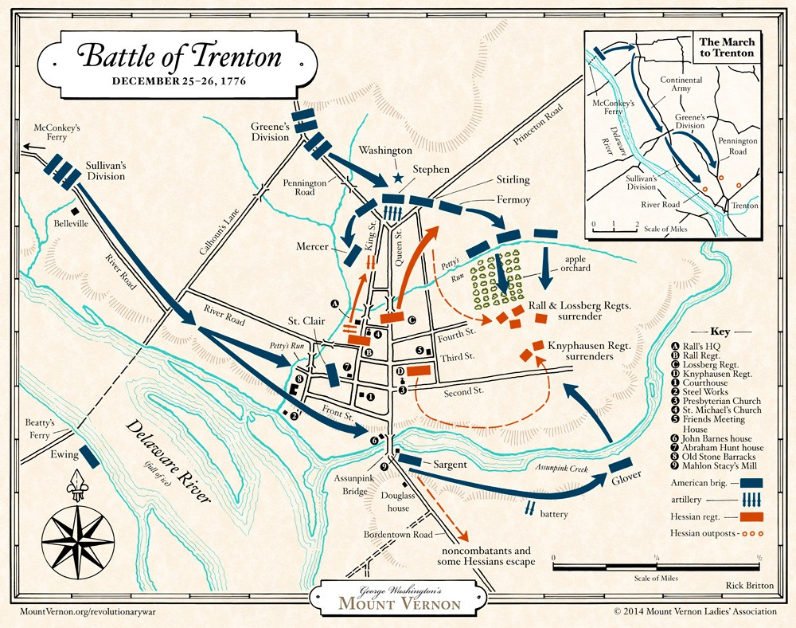
Notes:
Planned 3 seperate crossings, Ewings and Cadwater’s troops were to cross, however they turned back when they came across the icy water. Washington crosses 10 miles north of Trenton then has to march another 10 miles back down to attack the Hession garrisson. Plan was 3 hours behind due to illness, soldiers tired, hungry, cold etc. Col. Knox brought alot of artillery, cannons made it across the river and placed at the top of the town.

Slide 23
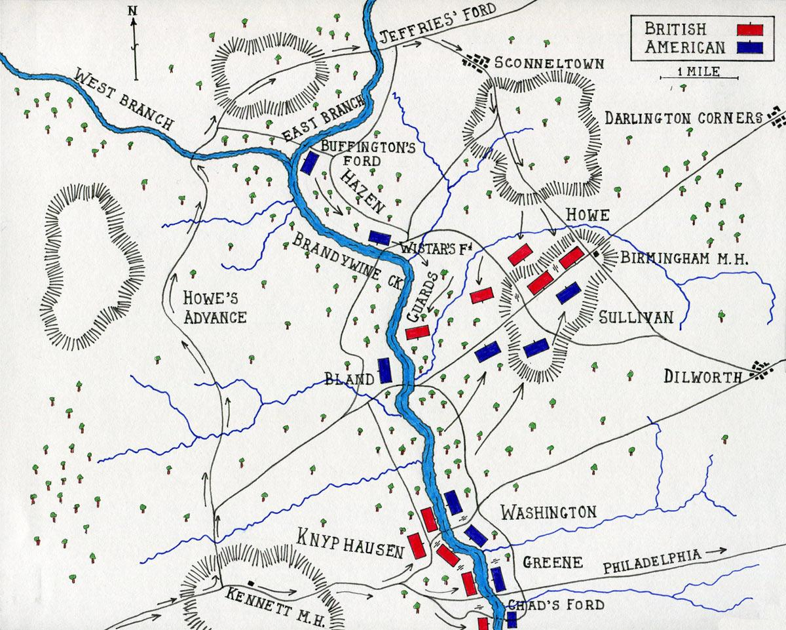
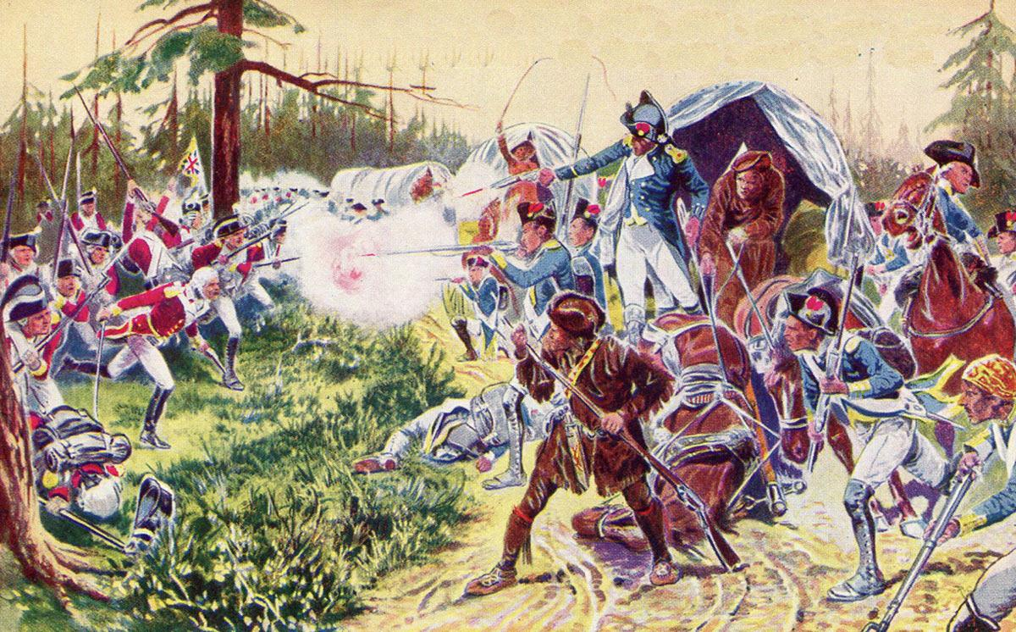
Turning Point
Britain came up with a new plan for victory
British Victory at Brandywine
Notes:
3 armies were to meet at Albany, the plan is to separate new england colonies from southern, armies never met up.

Slide 24
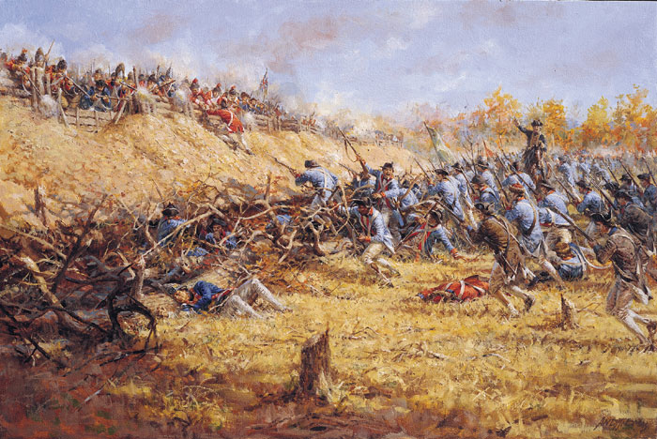
Battle of Saratoga, NY
1777
colonial victory
turning point of the war
French become allies
Notes:
British general John Burgoyne’s army marched south from Canada, American volunteers faced Burgoyne & his men, after several weeks of fighting Americans win and the British are forced to surrender. Demonstrated to the French that Americans can win this war. Signed treaty with the U.S. first country to do so.

Slide 25
Valley Forge, PA
winter 1777
suffered from hunger and frostbite
more than 2,000 soldiers died
Notes:
‹#›
Even witht the help of the French, Washington’s troops were ill supplied. British troops occupied Philadephia and spent the winter in the comfort of the city while Washington and his troops spent the winter at Valley Forge with little to no supplies.

Slide 26
Going Down South
War in the South
1778-British shifted war to the south
British controlled cities, but Patriots strong in rural areas
Hit and run attacks
Supply lines
Notes:
British believed they had loyal support in the South, captured Savannah & Charleston in South Carolina. The British burned houses, barns, livestock and crops

Slide 27
Yorktown, VA
French naval force defeated British fleet
Continental Army surround British
October 19, 1781: British surrender
QW: What does Hamilton mean by “the world turned upside down?
Notes:
American & French capture 2 British posts. Allies can now fire into the British camp at Yorktown. British thought their navy could help, French navy blocks them from helping Yorktown. British are surrounded. An officer comes out with a white flag to surrender. The defeat at Yorktown means American’s fight for Independence had been won.

Slide 28
Treaty of Paris
1783 war ends
British recognized the USA as independent nation
Americans are given land from Atlantic Ocean to the Mississippi river
Notes:
‹#›

Slide 29
What’s next?
Who should participate in government?
How should the government answer to its people?
Who should be represented in government?
If you were a member of the Continental Congress how would you answer these questions?
Notes:
‹#›

