Slide 1
The Stirrings of Rebellion
TOPIC: The Road to the
Revolutionary War

Slide 2
Down To Business
Essential Question
What events led colonists toward a revolution with Britain? Why?

Slide 3
Why Do I Care, Miss McCormack?
The British created a legacy of heavy taxation and laid their financial burdens on to the colonists of North America. Without a true voice in English Parliament the people felt they were being walked all over. The controversial decision to declare independence from the mother country, England began to bubble over in the mid-1700’s until there seemed to be no other reasonable solution.

Slide 4
Quickwrite
Make a list of the top 3 things that make you upset

Slide 5
French and Indian War
France & Britain compete for land in N. America
French form an alliance with Native tribes
British Victory (Treaty of Paris 1763):
Britain gains all land E. of the Mississippi River

Slide 6
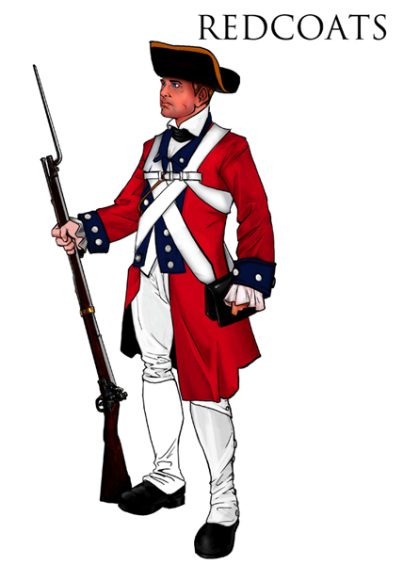
Why Won’t They Leave?
British actions AFTER war:
left British soldiers in the colonies
forced families to house soldiers
Soldiers seen as a threatening presence.
imposed greater authority
strictly enforced British law
created new laws to remove power from Colonial Assemblies
people saw this as a threat to their freedom

Slide 7
Sugar Act (1764)
English avoided sugar taxes making foreign-made molasses more expensive
taxes were enforced & sugar costs went up
smuggling increased
Smugglers prosecuted by high courts
Sugar Act: Maroon 5

Slide 8
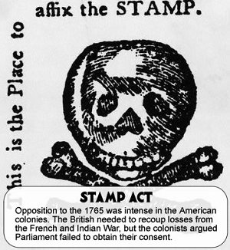
Stamp Act (1765)
direct tax
required colonists to purchase special stamped paper for ALL paper/documents
taxed packages of playing cards and dice, etc.

Slide 9
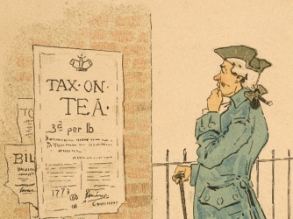
Townshend Acts (1766)
taxed imported materials such as glass, lead, paint, and paper
3-cent tax on tea

Slide 10
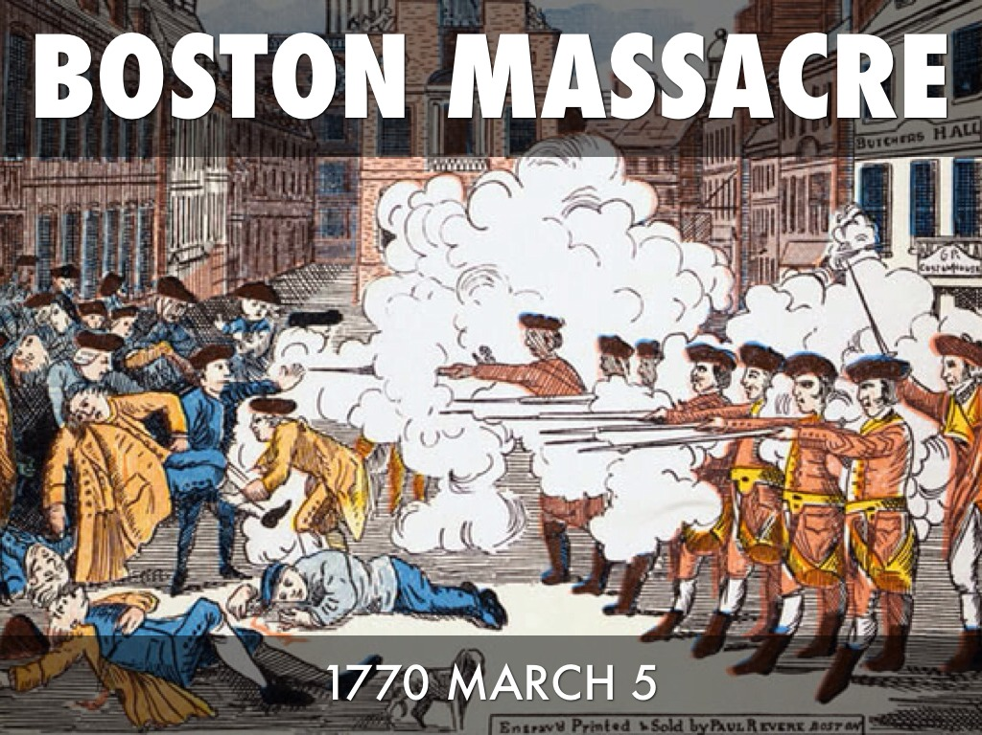
Boston Massacre (1770)
colonists angry over scarce number of jobs
a mob throws snowballs at the at guards at the Customs House to taunt
guards shot & killed 5 colonists

Slide 11
The Tea Act (1773)
angered American colonists because it:
tax on a popular consumer item
created competition between eastern merchants & western farmers
followed the closing of Boston Harbor
granted the East India Company a virtual monopoly on the tea trade

Slide 12
Coercive/Intolerable Acts (1774)
Boston Port Act
closed the port of Boston until the East India Company had been repaid for the destroyed tea and until the king was satisfied that order had been restored
Massachusetts Government Act
altered the government of Massachusetts to bring it under control of the British government, declared that almost all positions in the colonial government were to be appointed by the governor or the king, and strictly limited the town meetings in Massachusetts
Administration of Justice Act
allowed the governor to move trials of accused royal officials to another colony or even to Great Britain if he believed the official could not get a fair trial in Massachusetts
Quartering Act
allowed a governor to house nearly 10,000 soldiers in other buildings if suitable quarters were not provided

Slide 13
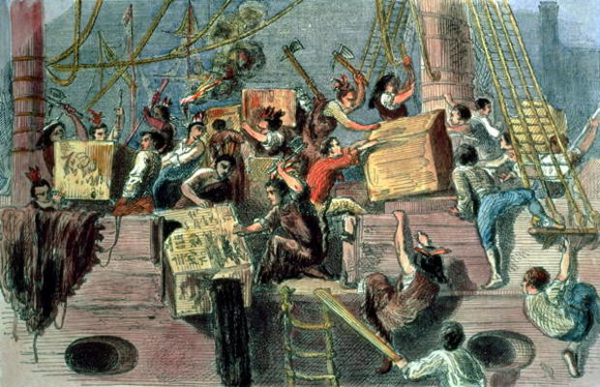
Colonists’ Reactions
Sons of Liberty; Samuel Adams
organize to threaten, tar & feather, and burn stamps/stamp collectors
boycotts
Boston Tea Party (1773)

Slide 14
Summary Time

