Slide 1
Because We Said So…
Topic: Manifest Destiny in the U.S.A.

Slide 2
Down to Business
Essential Question
What motivated Americans to go West & start a new life?
What was life like in the Western territories?

Slide 3
Why do I care, Miss McCormack
The settlement of the United States is full of conflict, confrontations, and what at the time did not seem like complicated events. However, the legacy of manifest destiny plagues the nation today as we experience conflicts with multiple ethnic groups within and outside of our borders.

Slide 4
Vocabulary Pit Stop
Manifest Destiny: belief that it was the “god given right” of the U.S. to expand westward toward the pacific ocean.

Slide 5
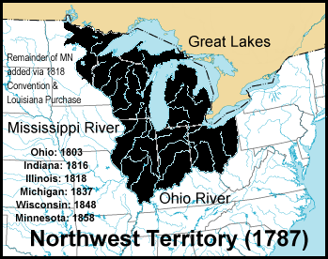
Northwest Ordinance, 1787
allowed US gov. to acquire new lands
by admitting new states not by expanding existing states.
prohibited slavery in the new territory

Slide 6
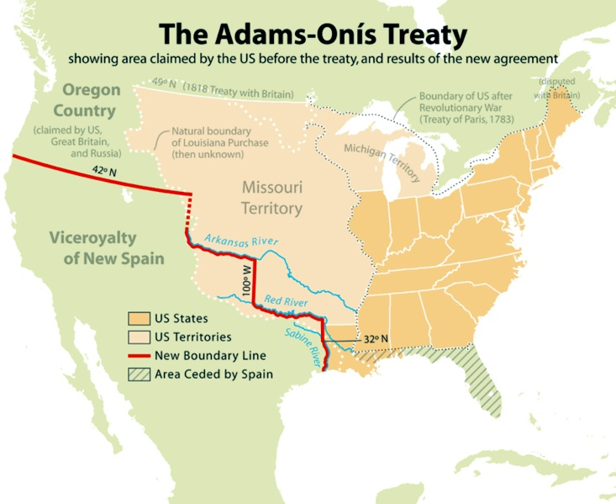
Florida, 1819
Adams-Onis Treaty
Spain ceded Florida
also gave up claim to Oregon Territory

Slide 7
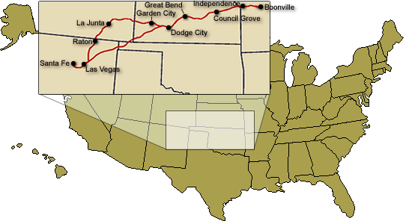
Moving West (1)
Santa Fe Trail
left from Missouri
traveled S. across the Great Plains into the New Mexico (NM) Territory

Slide 8
Moving West (2)
Oregon Trail
left Missouri
traveled N. across Great Plains, Rocky Mtns, Cascade Mtns, into Oregon (OR) Territory
2,170 miles, 15 miles a day
Notes:
5-10 percent of people died on the Oregon Trail
typhoid fever, broken bones, snake bites, dysentery etc

Slide 9
Frontier Livin'
Americans moved west for/to
cheap land
trade with Asia
escape economic problems
Panic of 1837: banks failed; savings lost
fresh start

Slide 10
American Progress (1872)
Left Side
Below the picture list a minimum of 5 things you see going on in this picture.

Slide 11
American Progress (1872)
Left Side
How do you think this picture reflects the idea of Manifest Destiny?

Slide 12
Missouri Compromise,1820
1818: problem: admitting new states to the union
10 free states & 10 slave states
need to keep the balance in the Congress
1820: solution:
Maine admitted as a free state
Missouri admitted as a slave state
36 degrees 30’ N established
south: slave states
north: free states
effect:
kept the “peace”
continue to ignore the problem of slavery

Slide 13
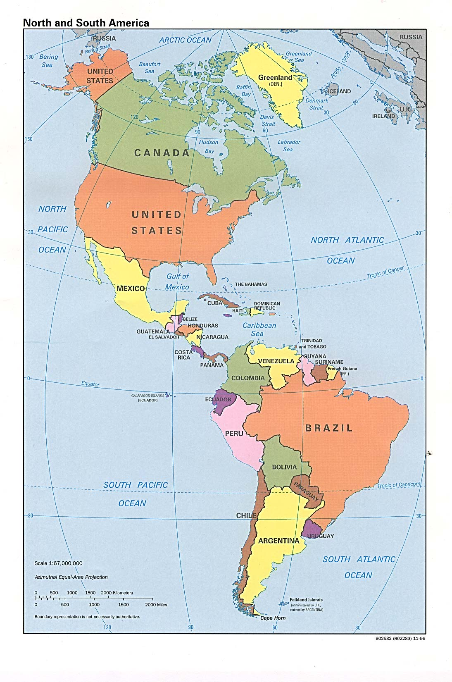
Monroe Doctrine, 1823
U.S. not allow Euro. nations to interfere in affairs in W. Hemisphere
overthrowing newly independent nations
In return, U.S.A. stayed out of issues in E. Hemisphere

Slide 14
Quickwrite
If you moved to another country would you learn their language follow their religion and participate in their culture? Why?
____________________________________________________________________________________________________________________

Slide 15
Expansion into Texas
Mexicans received independence from Spain (1821)
wanted to improve economy
reduce trade restrictions w/ U.S.
Mexico encouraged Amer. farmers to settle in Texas
land granted IF settlers:
obey Mexican law
practice Roman Catholicism

Slide 16
Texas Independence, 1836
Battle of the Alamo
Mexican forces killed 187 Americans
Republic of Texas formed
General Santa Ana captured
1845: Texas admitted as a state
ALAMO

Slide 17
Mexican-American War
1846-1848
President Polk provoked war by blockading the Rio Grande River
“Mexico has passed the boundary of the United States, has invaded our territory and shed American blood upon American soil. She has proclaimed that hostilities have commenced and that the two nations are now at war. As war exists, and, notwithstanding all our efforts to avoid it, exists by the act of Mexico herself, we are called upon by every consideration of duty and patriotism to vindicate with decision the honor, the rights, and the interests of our country.”

Slide 18
Treaty of Guadalupe Hidalgo
US acquired present day:
California (CA)
Nevada (NV)
New Mexico (NM)
Utah (UT)
most of Arizona (AZ)
parts of Colorado (CO) & Wyoming (WY)
Guadalupe Hidalgo Song
Guadalupe Hidalgo Treaty

Slide 19
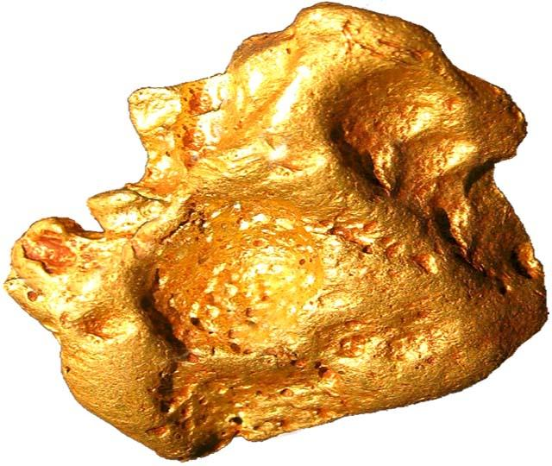
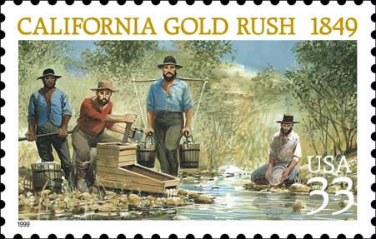
California Gold Rush, 1849
discovery of Gold in the new CA territory thousands of people went to strike it rich
“fourty-niners”
Population spiked from 4,000 to 44,000
California admitted as a free state in 1850

Slide 20
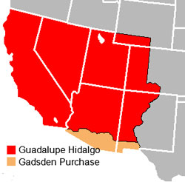
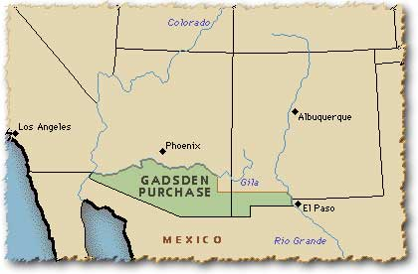
Gadsden Purchase (1)
1853
purchased from Mexico
$10 million
Southern portion of AZ and Southwest corner of NM
including Tucson
45,535 square miles

Slide 21
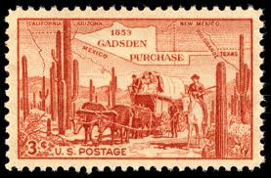
Gadsden Purchase (2)
Purpose: direct route for the Southern transcontinental railroad.
Problem: railroad would run South of the U.S. border
Solution: acquire the land from Mexico.

Slide 22
Who’s Destiny is this anyway?
Indian Wars
1800’s many conflicts btwn settler/U.S. gov. & Natives
natives often seen as “in the way” of progress
Dawes Act 1887
Tried to force assimilation of natives
Forced tribes to move to reservations

Slide 23
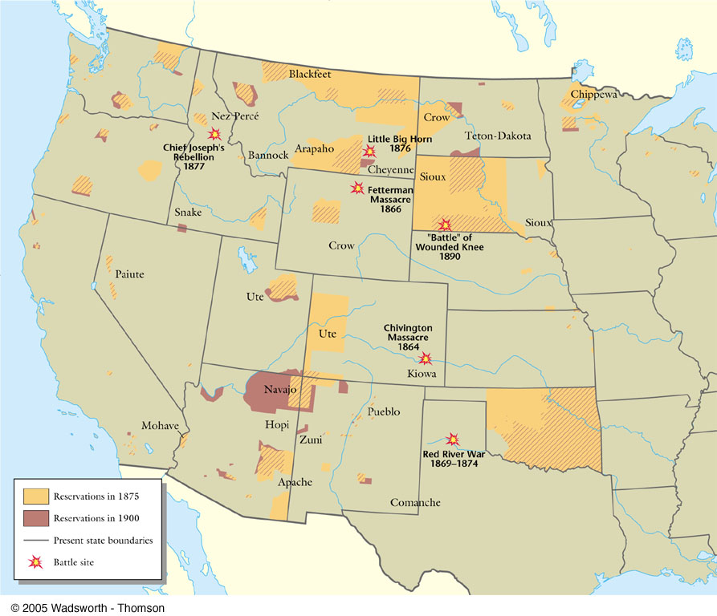
Relations with the Natives
conflicts over land and resources
Treaty of Fort Laramie (1851)
Americans would stay off of Native American land
* not honored by the United States government*

Slide 24
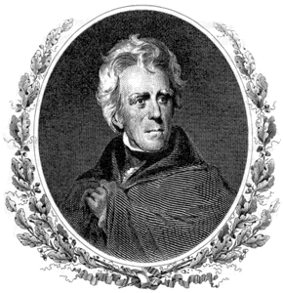
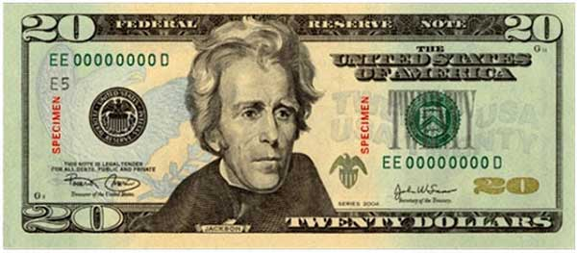
Andrew Jackson
7th U.S. President (1829-1837)
“Jacksonian Democracy”
“champion of the common people”
supported small/limited federal government
relocated native tribes west of Mississippi River
collapsed National Bank U.S.
supported slavery

Slide 25
LET’S COMPARE
How is your political cartoon similar to the Manifest Destiny political cartoon?
How are they different?
Why did you think the artist drew certain images to reflect Manifest Destiny?
Why did you choose your images to represent Manifest Destiny?
Did you choose to leave anything out?

