Slide 1
WE ARE NEVER EVER GETTING BACK TOGETHER
Title: Declaration of Independence
Notes:
‹#›

Slide 2
DOWN TO BUSINESS
Essential Question:
Why would the Declaration consist of four parts?

Slide 3
WHY DO I CARE, MISS MCCORMACK?
The great thinkers and intellectuals of each generation are usually the people who lead cultural, political, or social movements. The revolutionary ideas of great thinkers in the colonies about independence and basic human freedoms led the colonies in America toward war with England.
This is why you get educated…be a great thinker!
Notes:
‹#›

Slide 4
QUICKWRITE
Is loyalty more important to you than having your independence? Why?

Slide 5
BREAKING UP IS HARD TO DO
Declaration of Independence
Given to Congress on July 2, 1776
July 4, 1776
Approved by congress
Delegates who signed were committing treason
4 parts
1. preamble
2. political principles explaining the rights of the people
3. list of intolerable acts of King George III
4. actual declaration of independence from Britain

Slide 6
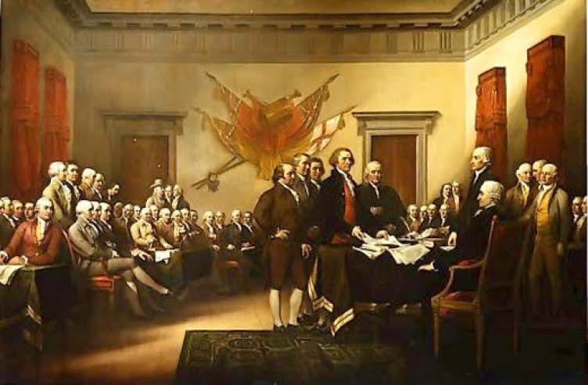
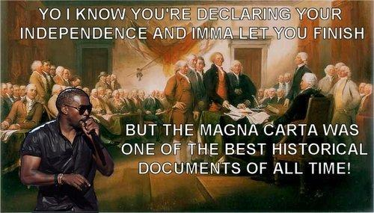
SIGNING OF THE DECLARATION OF INDEPENDENCE
< Real
Real Funny>

Slide 7
1. PREAMBLE
“…We hold these truths to be self-evident, that all men are created equal, that they are endowed by their Creator with certain inalienable rights, that among these are life, liberty and the pursuit of happiness…”
States basic principles of democracy
Natural rights given by God
“life , liberty, and the pursuit of happiness”
People form governments to protect them

Slide 8
2. POLITICAL PRINCIPLES
“…That to secure these rights, governments are instituted among men, deriving their just powers from the consent of the governed. That whenever any form of government becomes destructive of these ends, it is the right of the people to alter or abolish it, and to institute new government, laying its foundation on such principles and organizing its powers in such form, as to them shall seem most likely to effect their safety and happiness…”

Slide 9
3. ANGER WITH THE KING
“…For cutting off our Trade with all parts of the world…
For imposing Taxes on us without our Consent…
For depriving us in many cases, of the benefits of Trial by Jury…”
Notes:
‹#›

Slide 10
ANGER WITH THE KING
List of grievances
Taxed colonist without their consent
Destroyed self government
Stopped colonist from moving west
British troops in colonies during peacetime

Slide 11
4. SEPARATION
“…We, therefore, the Representatives of the united States of America, in General Congress, Assembled, appealing to the Supreme Judge of the world for the rectitude of our intentions, do, in the Name, and by Authority of the good People of these Colonies, solemnly publish and declare, That these United Colonies are, and of Right ought to be Free and Independent States; that they are Absolved from all Allegiance to the British Crown…”

Slide 12
SEPARATION
Declared independence
Colonies have now become the United States of America
All political ties with Britain cut

Slide 13
WHO’D THEY LEAVE OUT?
Enslaved Persons
Women
Native Americans
QW: why do you think they left them out?
Notes:
‹#›

Slide 14
Ideals vs Reality
Declaration stated “all men are created equal”
ideal , however not reality
Women, slaves & natives
500,000 slaves in colonies
First draft of Declaration attacked slavery
He has waged cruel war against human nature itself, violating its most sacred rights of life and liberty in the persons of a distant people who never offended him, captivating and carrying them into slavery in another hemisphere, of to incur miserable death in their transportation hither. . . . Determined to deep open a market where men should be bought and sold . . .”

Slide 15
Abigail Adams
Urged John Adams to remember the women
Even though the country could not live up to the words now, it would become the source for future rights
Debating loyalties
Divided loyalists
Patriots favored independence
Loyalists stayed faithful to Britain

Slide 16
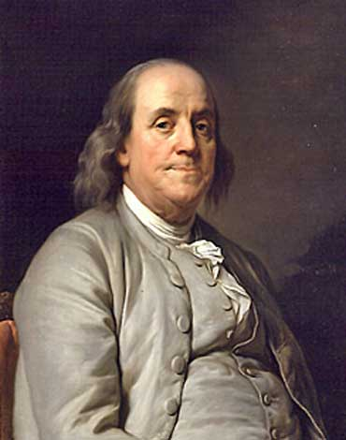
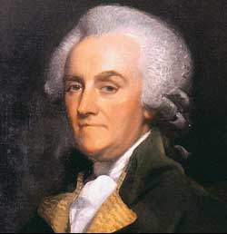
Families divided
Benjamin Franklin’s son a loyalist
⅓ Patriots, ⅓ loyalists, ⅓ don’t care
Loyalists driven from their homes
Fled to England

Slide 17
SUMMARY TIME:
CONSIDER THE NOTES, THE DOCUMENT AND THE ESSENTIAL QUESTION IN YOUR SUMMARY

Slide 18
IT’S NOT YOU IT’S ME
Using the same format as our Founding Fathers write your own break-up letter to the King George III.
Must include:
introduction
Explanation of the ways in which the King has done wrong
Explain that you are now separate.
LEFT SIDE OF YOUR NOTEBOOK
A little inspiration…courtesy of T. Swift

