Slide 1
America & THE MARKET REVOLUTION

Slide 2
Down to Business
Essential Questions
What impact did new technology have on America in the 1800s?
How did this influence the move Westward?

Slide 3
Why do I care,Miss. McCormack?
Nearly every facet of modern society hinges on some sort of technology. Inventions that our Founding Fathers could not have even dreamed of. Even as early as the 1800’s America was becoming a land of cutting edge technology. Soon there would be machines that could lessen the burden on American workers and later would transform society. However, we could argue that none of it would have been made possible if not for the desire to meet the needs of the rapidly growing United States. After all, “necessity is the mother of all invention.”

Slide 4
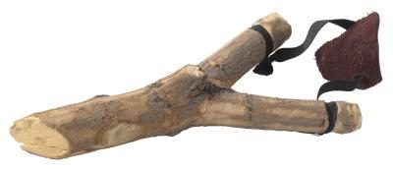
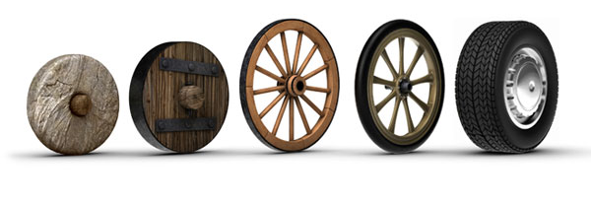
QUICKWRITE:
What do you think is the best invention humans have ever come up with? Why?

Slide 5
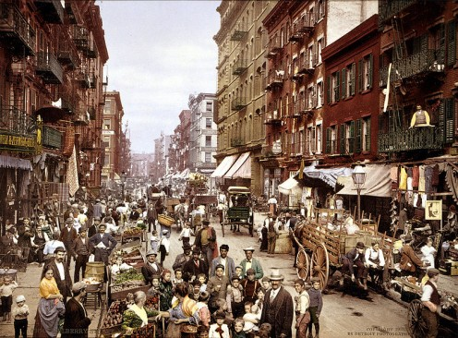
The Market Revolution (1)
the United States was becoming more industrialized in the first half of the 1800’s
workers spent money on goods made by others
as technology improved the cost of goods became less expensive

Slide 6
The Market Revolution (2)
Causes | Effects
new inventions Examples: sewing machine, telegraph, steamboat | improved standard of living improved manufacturing, transportation, and communication
specialization | farmers began to mass produce 1 or 2 crops to sell
interdependence/ regionalization | regions became very efficient at producing a type of good Examples: South = agriculture Northeast = manufacturing

Slide 7
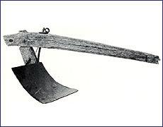
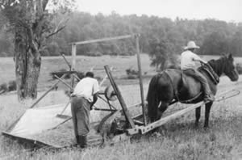
Improved Manufacturing
steel plow
John Deere
cleared the land more efficiently
mechanical reaper
Cyrus McCormick
harvest the crop more efficiently

Slide 8
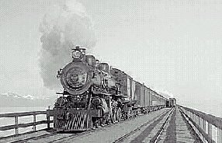
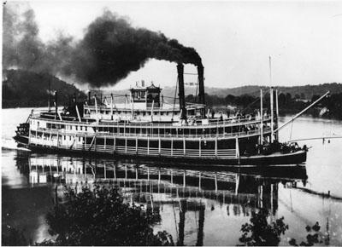
Improved Transportation
railroads
transportation more expensive than canals
moved faster than canals
steamboats
traveled quickly
cheap transportation of goods

Slide 9
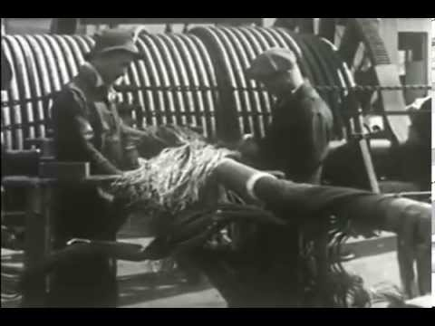
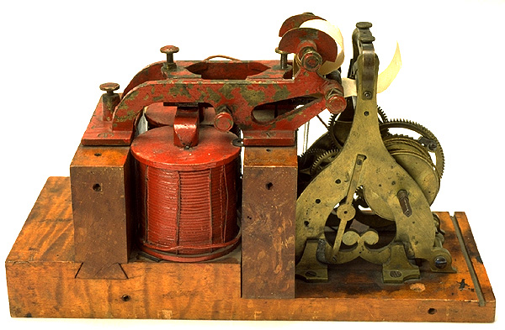
Improved Communication
telegraph
Samuel F. B. Morse
Morse Code
send messages by wire in seconds
transmit orders
get up-to-date prices
keep trains running safely and on time

Slide 10
REGIONAL ECONOMIES CREATE DIFFERENCES
Chapter 7 Section 1
Answer all 6 questions in complete sentences.
Tape this GREEN paper to the LEFT SIDE of these notes when you are finished.

Slide 11
Skit…
Each group will be given one of the five major inventions of the market revolution.
The group must create a 2-4 minute skit that explains what the invention is and how it works.
All group members must have a speaking role to play in the actual skit.
Use the left side page for this lecture to write your skit (every group member needs a copy of the skit).
*Skits will be presented in class tomorrow*

