Slide 1
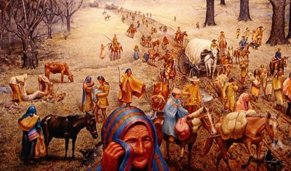
TRAIL OF TEARS
Topic: Andrew Jackson & Indian Removal Act

Slide 2
DOWN TO BUSINESS
Essential Question
Analyze the choice made to move Native American Tribes to Reservations.

Slide 3
WHY DO I CARE, MISS MCCORMACK?
The Indigenous people of North America struggled to adapt to the change in their culture, lifestyle, and land as Europeans began to claim America for themselves. Sadly, their voices, and culture was not equally represented during this time period and left them disenfranchised by the United States government as it sought to move westward and expand the nation.

Slide 4
WHAT MAKES YOU FEEL AT HOME?
Quickwrite

Slide 5
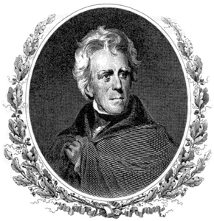
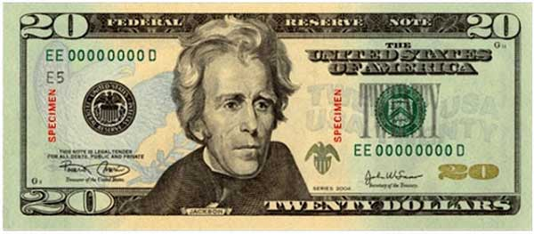
ANDREW JACKSON
7th U.S. President (1829-1837)
“Jacksonian Democracy”
“champion of the common people”
supported small/limited federal government
relocated native tribes west of Mississippi River
collapsed National Bank U.S.
supported slavery

Slide 6
Five Tribes
125,000 Natives live east of Mississippi River
Cherokee, Seminole, Chickasaw, Creek, Choctaw live in the South
Five tribes
33 million acres of land
American settlers want the land
Notes:
President Jackson wants the land for settlers

Slide 7
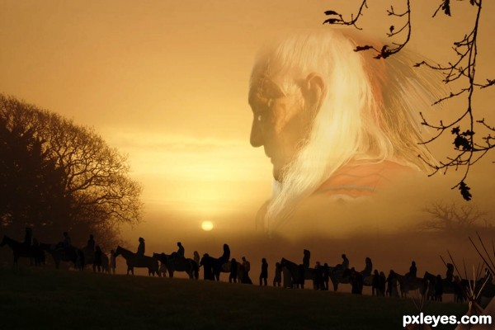
TRAIL OF TEARS
1830: Indian Removal Act
all Native Americans moved west of the Mississippi
Notes:
The act was meant primarily for the five tribes
exchange land in the east for new land in the west

Slide 8
“We Will Not Go Quietly Into the Night...”
Cherokee will go to court
Supreme Court supports their claims
Jackson goes ahead with removal
1838
Cherokee forced from Georgia & sent to Oklahoma
Trail of Tears
800-mile trip to Oklahoma
Seminoles went to war
defeated and sent west
1840
60,000 Native Americans relocated west
Notes:
“We will not go quietly into the night, we will not vanish without a fight! Were going to live on! Were going to survive!”
15,000 cherokee forced to leave their homes
forced by baynot
one quater died on the trail due to disease, exposure and exhaustion

Slide 9
RELATIONS WITH THE NATIVES
conflicts over land and resources
Treaty of Fort Laramie (1851)
gave Native Americans control of much of the Great Plains
could not attack American settlers moving west
allowed U.S. Army to build forts and roads on the land
Americans would stay off of Native American land
* not honored by the United States government*

Slide 10
Treaty of New Echota
Major Ridge signed treaty with U.S
claimed to represent Cherokee Nation
Agreed to move the Cherokee Nation west
$5million
Chief John Ross did not approve
rejected the treaty
Allowed the U.S to legally force Cherokee West
Notes:
Treaty is ratified by congress

Slide 11
Let's Be Historians!
In pairs R.A.N on all Primary Documents from various perspectives
Answer Document A & B DBQs
Answer the following questions using all documents
1. Why did people in the 1830s support the Indian Removal Act?
2. What impact did the Indian Removal Act have on the Cherokee Nation
3. Did the Indian Removal Act violate the principles found in the Declaration of Independence?

Slide 12
SUMMARY TIME

Slide 13
MOVING WEST (1)
Santa Fe Trail
left from Independence, Missouri
traveled south across the Great Plains into the New Mexico Territory

Slide 14
MOVING WEST (2)
Oregon Trail
left from St. Louis, Missouri
traveled north across the Great Plains, the Rocky Mountains, the Cascade Range, and into Portland, Oregon

Slide 15
RAFT: USE THE INFORMATION COVERED IN CLASS AND THE GUIDELINES PROVIDED BELOW TO COMPLETE A HEADLINE, PICTURE & CAPTION THAT EXPLAINS THE INDIAN REMOVAL ACT.
Role:
Newspaper Editor
Audience:
Newspaper Readers
Format:
Front Page Picture
w/Caption & Headline
Topic:
Indian Removal Act

