Slide 1
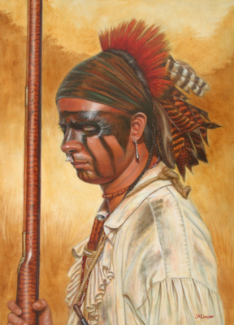
French Settlement & Conflict

Slide 2
Down to Business
EQ: How did the French Indian War impact the English colonists?

Slide 3
Why do I care Miss McCormack?
The French settlements and conflict changed the course for Britain and the colonies. Britain spent an enormous amount on the war. Britain looked towards the colonies to pay for the war, leading to resentment and eventually rebellion.

Slide 4
French Colonize America
French came to America in small numbers
Settlements based on
Geography
Economics
Natives
Came for fish and furs

Slide 5
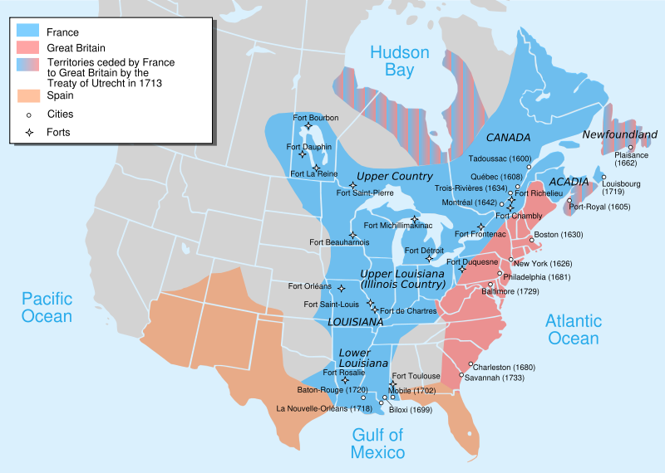
French Colonization

Slide 6
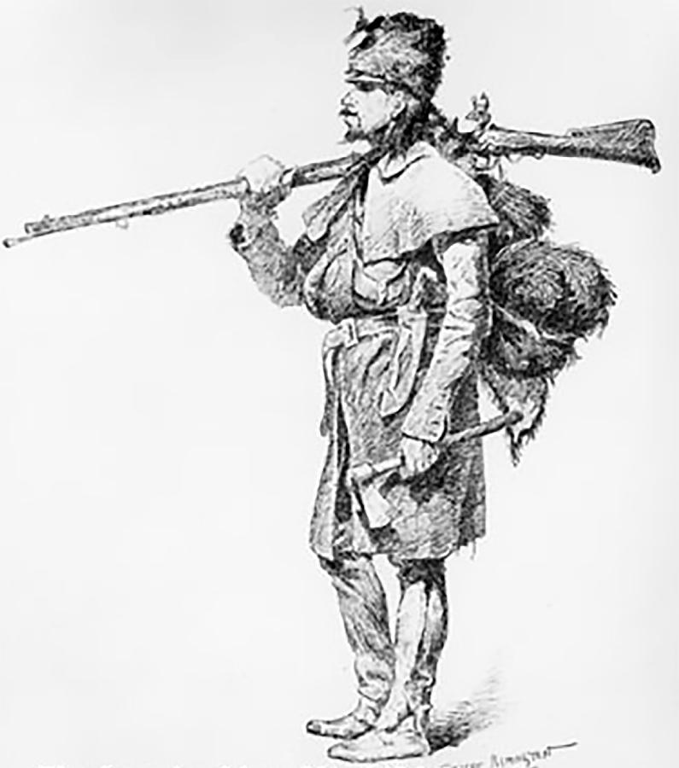
French Fur Trade
Quebec-first permanent settlement
Established friendship with Hurons
became enemy of Iroquois
French traders traveled deep into the heart of N. America
Coureurs de bois
Fur trader
Followed water routes
Notes:
Iroquois blocked french expansion into the south and west
Water routes, great lakes, mississippi river, ohio river valley

Slide 7
French Fur Trade
Hoped to establish vast trading network
Strong alliance with Natives
Huge profits for France
Population does not grow
Only 55,000 in New France
Over million in British colonies

Slide 8
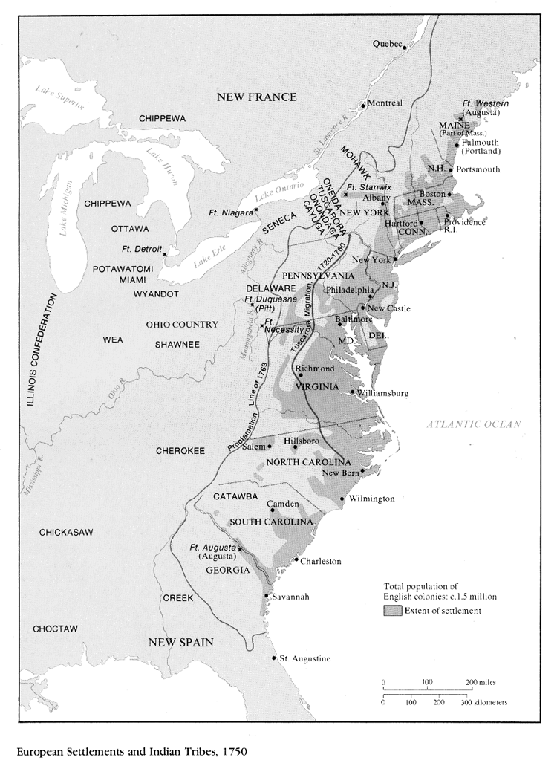
French Indian War

Slide 9
The French and Indian War
Early 1700s Britain not concerned with French
Mid 1700s things changed
British traders and colonists began crossing Appalachians
Both nations claimed Ohio River Valley
Both determined to drive out the other

Slide 10
The French and Indian War
The Albany Plan of Union
France as possible threat
Representatives from 7 colonies met in Albany, NY
Benjamin Franklin proposed a plan of union for colonies
All colonies form a council
Collect taxes
Lead military operations if war broke out
Both the colonies and British government rejected
First attempt to unite colonies

Slide 11
Join, or Die cartoon by Benjamin Franklin
Notes:
Printed in Franklin’s newspaper the Pennsylvania Gazette. Represented the Albany Plan, Delaware and Georgia not included in orginial union plan

Slide 12
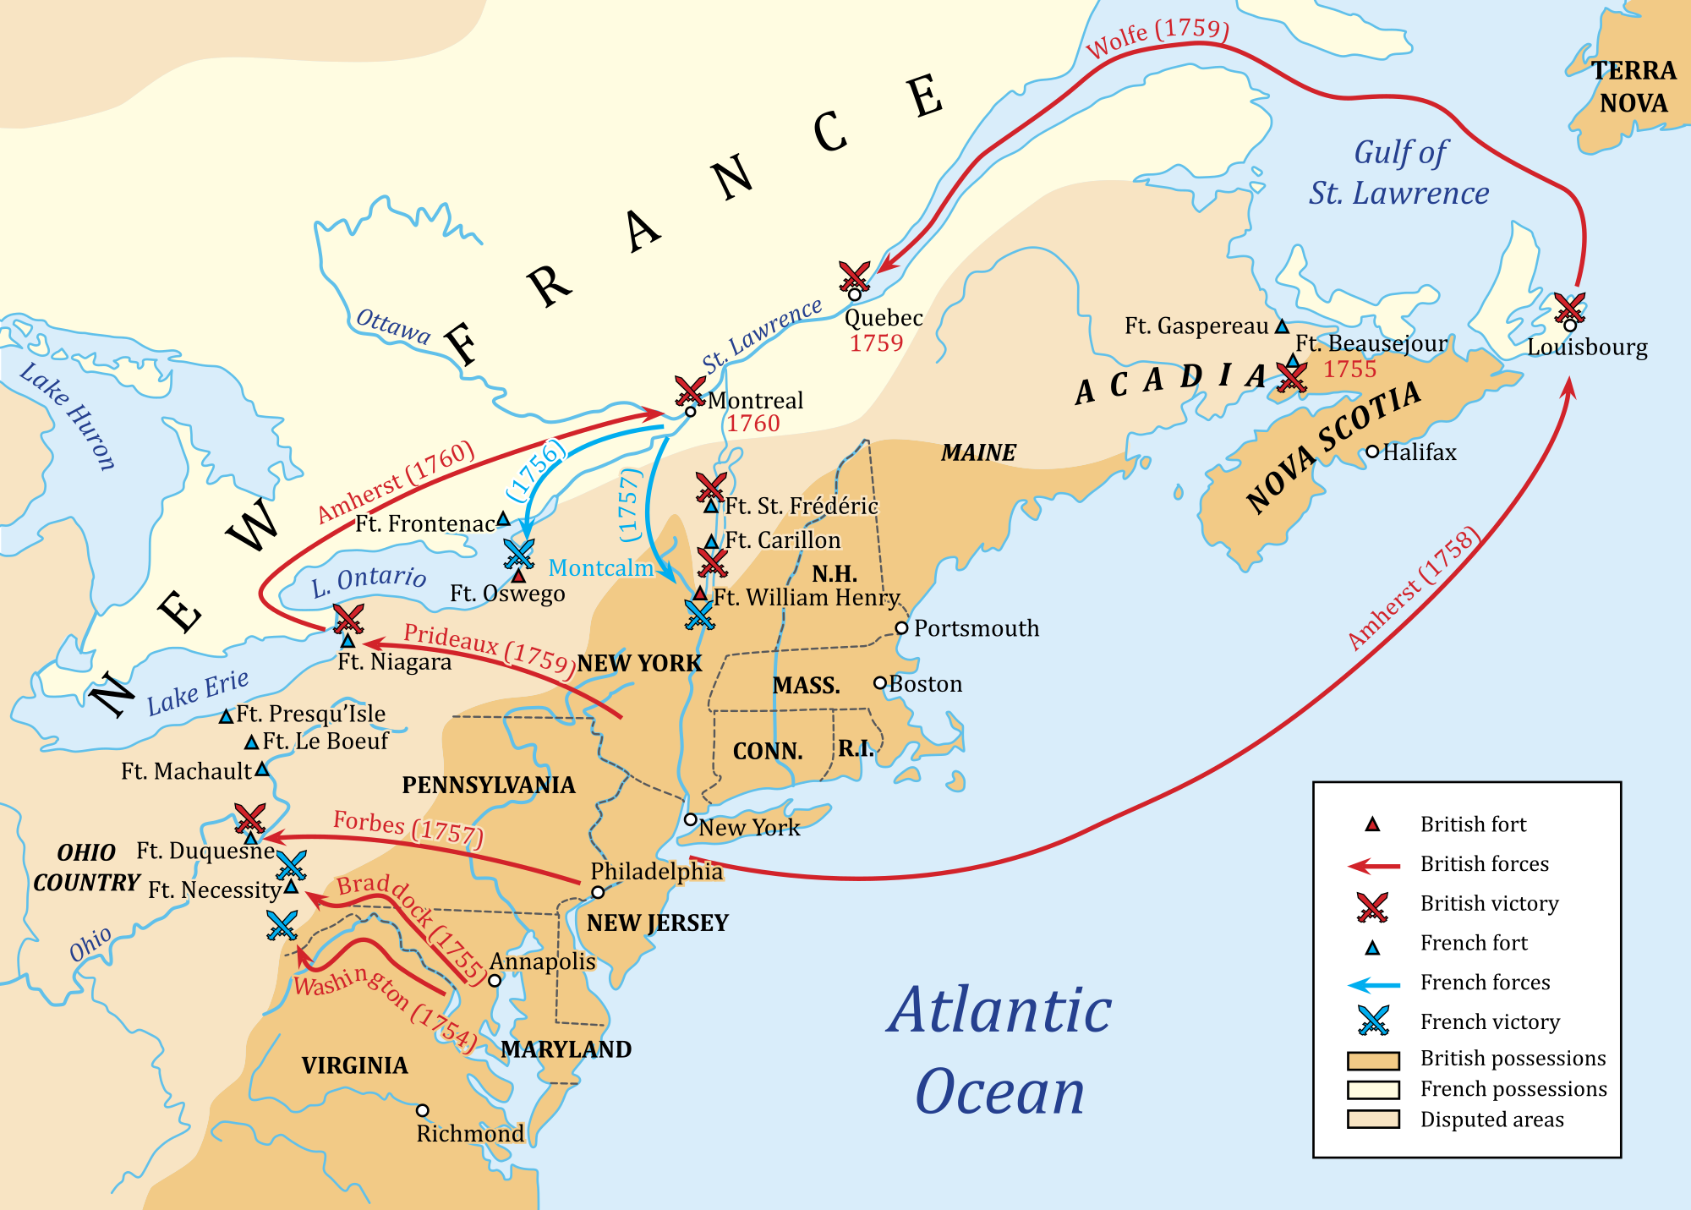
The French and Indian War
Native Americans Take Sides
Albany Congress also wanted to persuade Iroquois to British side
Hatred of Hurons and French led them to side with British
Most Natives side with French
Did not endanger Natives’ way of life

Slide 13
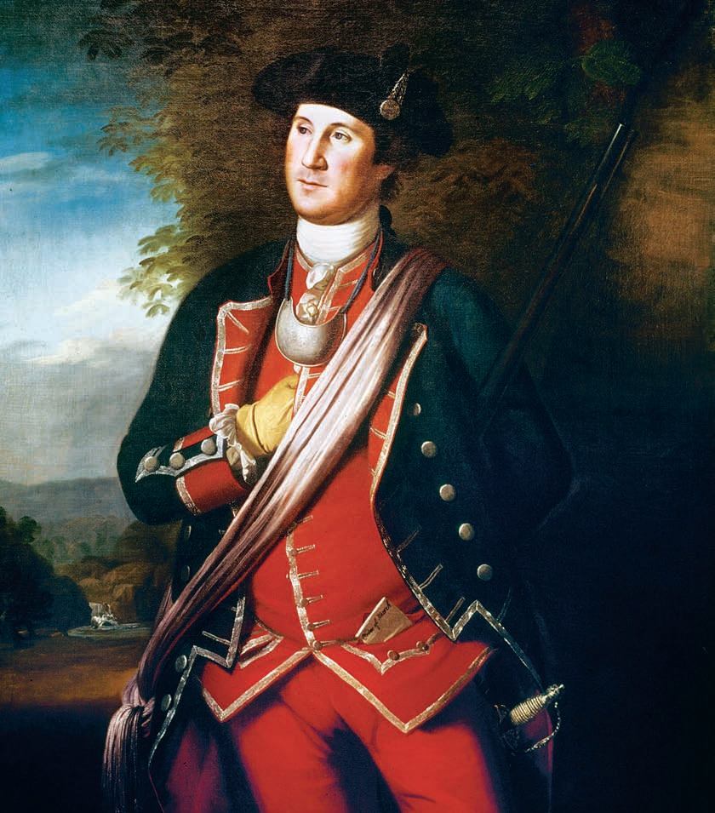
The French and Indian War
The War Begins
By 1753, French began building forts in Ohio River Valley
21 year old George Washington sent to warn French to get out
French determined not to leave

Slide 14
The French and Indian War
The War Begins
1754-Washington sent to defend British fort on Ohio River
French seized fort
Renamed Fort Duquesne
French and Natives defeated Washington
1755-British sent General Edward Braddock
Knew nothing about fighting in America
Over 900 British soldiers killed, including Braddock

Slide 15
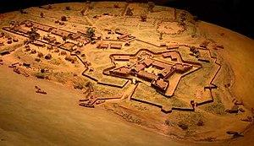
The French and Indian War
British seize Quebec
William Pitt became new Prime Minister
Put new emphasis on war in North America
Poured money and best generals into North America
1758-General James Wolfe led force
Captured Louisburg, Canada
Fort Duquesne renamed Fort Pitt
Made daring nighttime attacks on Quebec

Slide 16
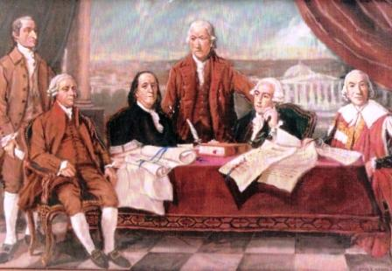
The French and Indian War
The British Seize Quebec
British easily captured Montreal and other French settlements within the next year
Spain entered war on French side, but too late
1763-France and Britain signed treaty ending war

Slide 17
The French and Indian War
French power in North America was gone
Ceded all lands to Britain
Spain cedes Florida & receives New Orleans
Britain will have colonists pay for the war
Taxes

