Slide 1
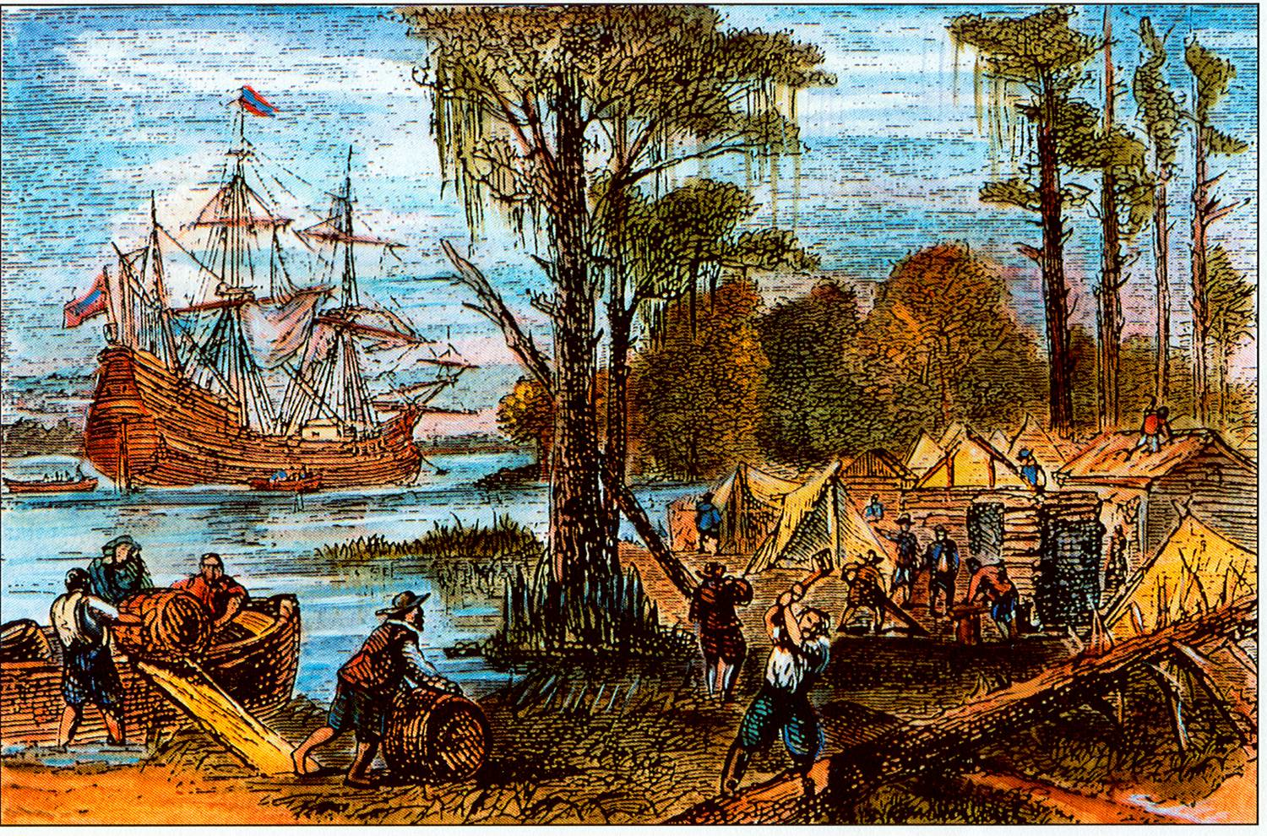
The English Have Landed!

Slide 2
Down to Business
Essential Question
.
EQ: What challenges did the British face when trying to establish colonies in North America?

Slide 3
Why do I care, Miss McCormack
From the moment that the English set sail for the “new world” the North American continent was forever changed. Our present day culture, government, etc. are deeply influenced by the English who came to colonize.

Slide 4
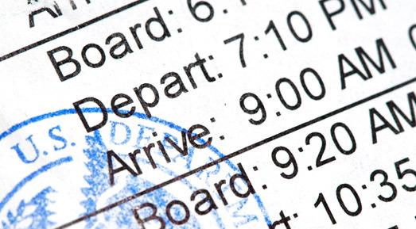
QUICKWRITE
Under what circumstances would you move to a new place knowing that you may never come back?

Slide 5
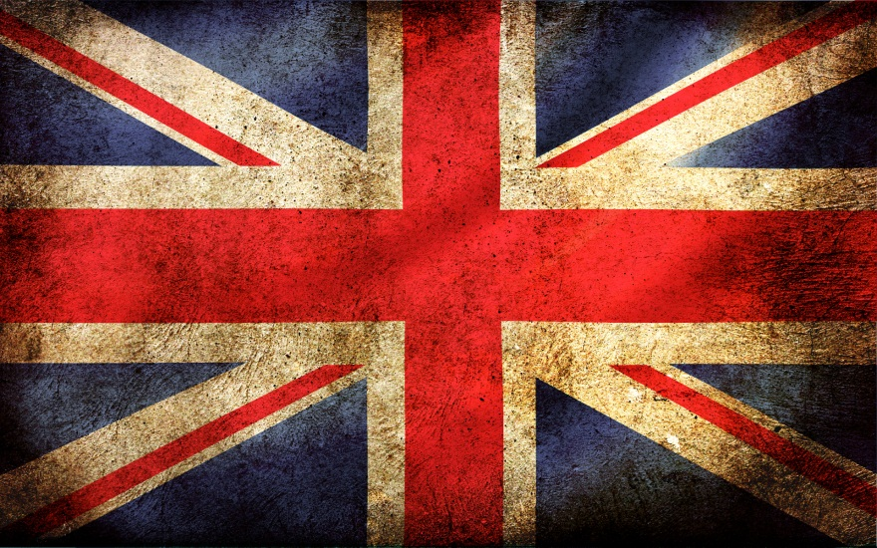
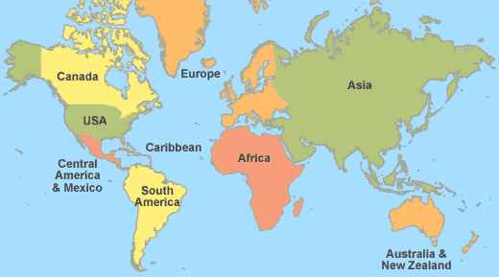
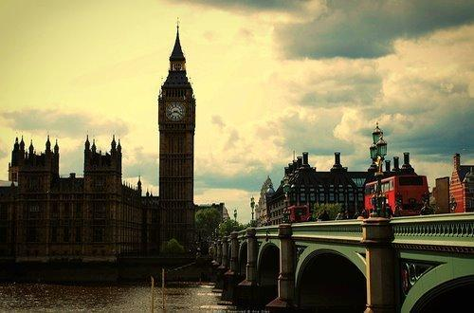
Where is England?
Are England and Britain the same place?

Slide 6
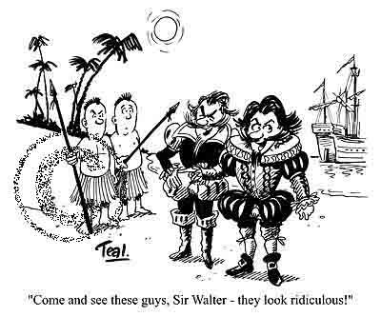
The Lost Colonists
Roanoke Island, N. Carolina
1587: Sir Walter Raleigh & 117 people settled on the island
1590: an English ship returned to Roanoke
No one was there

Slide 7
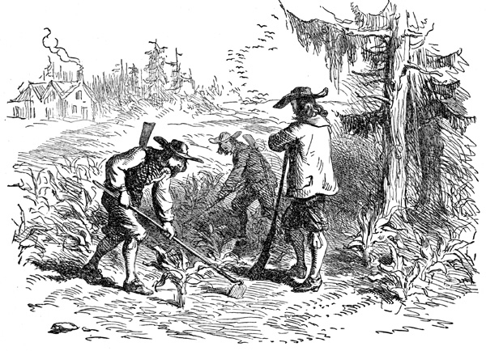
The Colonization Movement
English farmers grew food in N. America to fight starvation in Britain
Notes:
conditions in Europe had drastically changed with Spanish exploration
Spanish gold and silver flooded the market creating an inflated economy
without her own colonies, England suffered miserably from inflated prices
English farmers had begun growing food in the Americas which helped fend off starvation but contributed to the population boom
these factors combined increased the unemployment rate throughout England
‹#›

Slide 8
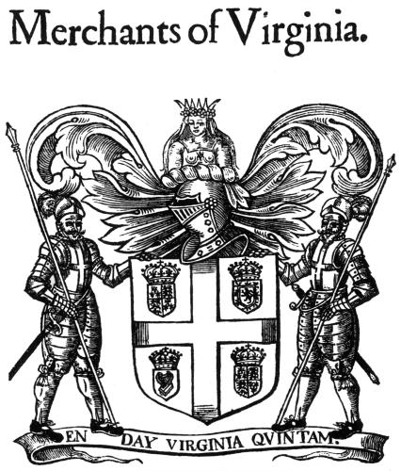
Paying for the Colonies
joint-stock companies
cover cost of transportation, settlement, and other expenses
People shared risks & profits
Virginia Company
larger company
held possession of large parcels of land

Slide 9
Jamestown (1)
1607: 3 ships with 100 men settled along the James River (Virginia)
faced extreme difficulties:
disease
starvation
conflicts with the natives
John Smith: “He that will not work, will not eat”
1609: another ship finally arrived
only 53 still alive
ship brought 400 more settlers
NO supplies
Notes:
Founded by a joint stock company, colonists were looking for gold while supplies dropped. Winter approaches and there is little food. John Smith gets food from local natives, then has men work for food later. “He that will not work, will not eat”

Slide 10
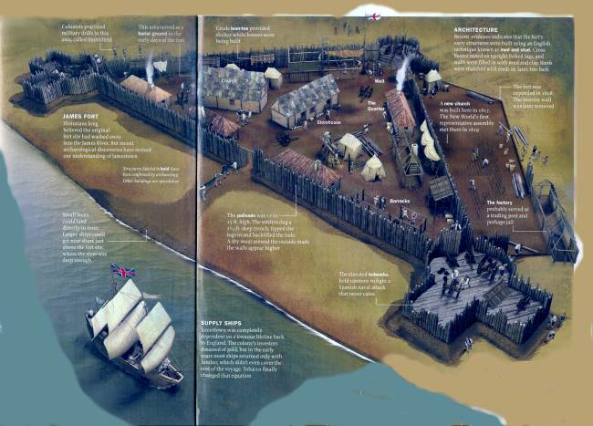
Jamestown (2)
the “starving time” (1609)
Faced a drought, limited crops
Only 60 survivors

Slide 11
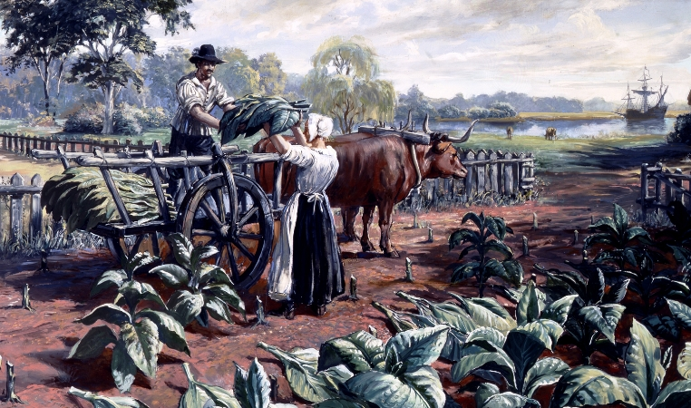
Then What?
Tobacco
Jamestown & Virginia struggles until tobacco
John Rolfe plants tobacco in Virginia
Cash crop: a plant that is grown for sale, not used by farmer
Known as green gold
Notes:
Green gold- used for trade instead of money, would become the main crop for more than 200 yrs, Virginia grew

Slide 12
Tobacco
By 1619 tobacco became the biggest cash crop
Tobacco led to physical expansion
Land could only support tobacco 2-3 years
Settlers needed more land
Tobacco would support the colony for 200 years

Slide 13
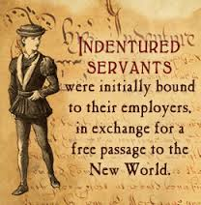
Virginia Expands
More people wanted to come to Virginia
Many can’t afford the trip
Sign agreements with tobaccos planters
Tobacco farmers paid for trip in exchange for service
Indentured servants became popular in Virginia

Slide 14
Separatists
1500s religious leaders break away from Roman Catholic Church
Church of England created
Separatists believed it was too similar
Break away from Church of England
Notes:
Wanted to purify the traditions of the church of England

Slide 15
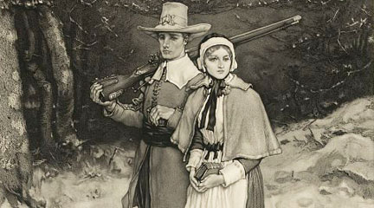
Pilgrims
Plymouth Colony, Massachusetts
2nd Permanent English Settlement
received permission from London Company
Signed the Mayflower Compact
First political document recognizing self-government
Barely survived first winter
Native tribes helped
Notes:
Suppose to reach Virginia, missed Virginia and hit New England. Came on the Mayflower and called themselves Pilgrims

Slide 16
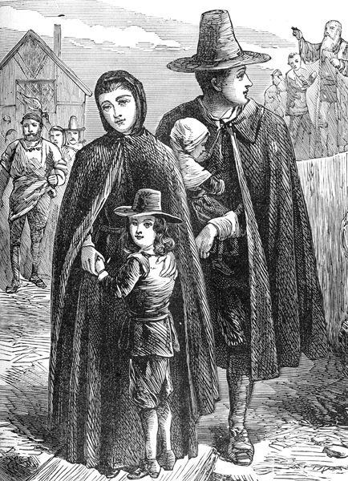
Puritans
Puritans-seeking religious freedom away from Church of England
Wanted to create a model new “pure” society
Obtained a charter from King James
Created the Massachusetts Bay Colony

Slide 17
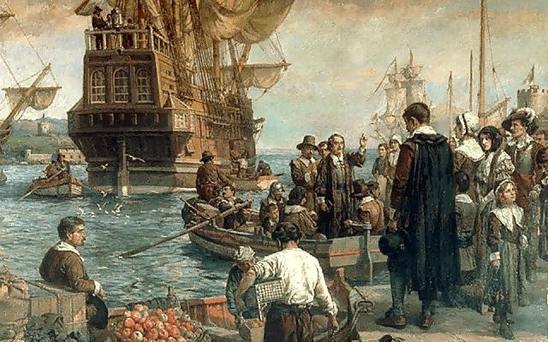
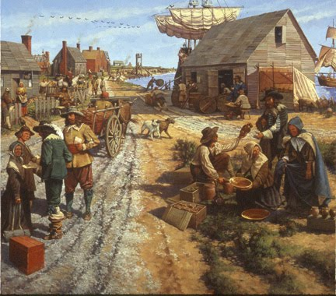
Massachusetts Bay Settlement
Placed a high value on education
Started Harvard College 1636
Public schools are created 1647
Strict Religious values controlled daily life, government, and business.
population grew quickly
caused land disputes with local native tribes
Developed strong business
trade & shipbuilding from Boston Harbor
Rebels
3.2.1
Notes:
High value on education. Needed to be educated in order to study the bible, first public schools created and paid for by taxes. Rebels: 15 minutes,

Slide 18
LEFT SIDE ACTIVITY
Venn-Diagram
Massachusetts Bay Colony
Jamestown
Colony

