Slide 1
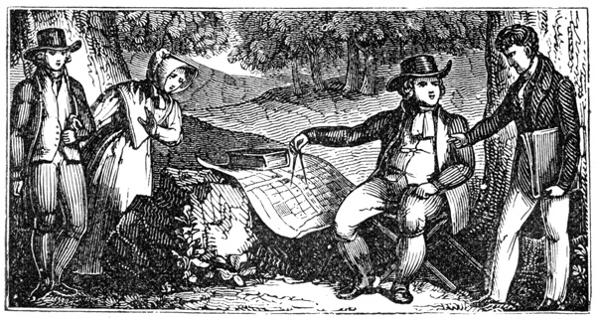
The 13 Colonies
Notes:
‹#›

Slide 2
Down to Business
Essential Question
What are the 3 colonial regions and what makes them different from one another?
Tape Map to the LEFT SIDE of these Notes ☺

Slide 3
Why do I care, Miss McCormack?
The colonies were settled for the benefit of the home country: England. As a result, many of the colonies existed to produce something that was needed by Englishmen. The colonists’ feelings about the economic system in place, mercantilism, evolved over time and eventually led the colonists to rebel.
Notes:
‹#›

Slide 4
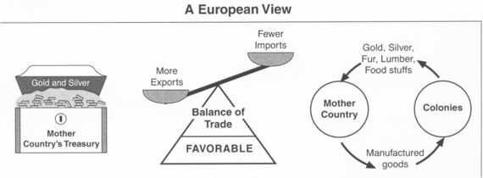
Why Colonize?
England wanted GOLD
did not want to pay for the colonies (mercantilism = self-sufficiency)
two ways to become wealthy:
obtaining gold & silver
establishing a favorable balance of trade = more exports (out) than imports (in)

Slide 5
People moved to the colonies for many reasons
riches
religion
fresh start
land
Had to learn how to adapt to the new land
WHY MOVE?

Slide 6
Colony Rules:
Should:
provide raw materials
lumber
furs
grain
tobacco
Should NOT:
export to countries other than the England
Notes:
‹#›

Slide 7
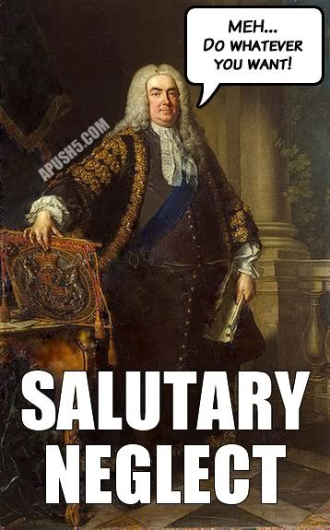
Enforcement Of English Law
restricted colonial trade with other nations
heavy taxes
Salutary Neglect= no financial help to colonies from England.

Slide 8
Colonial Regions
Commercial North
*AKA New England
Religious Middle
Agricultural South

Slide 9
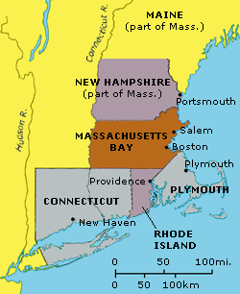
Northern Colonies “Commercial North” / “New England Colonies”
1620: Massachusetts
1623: New Hampshire
1633: Connecticut
1636: Rhode Island
Notes:
‹#›

Slide 10
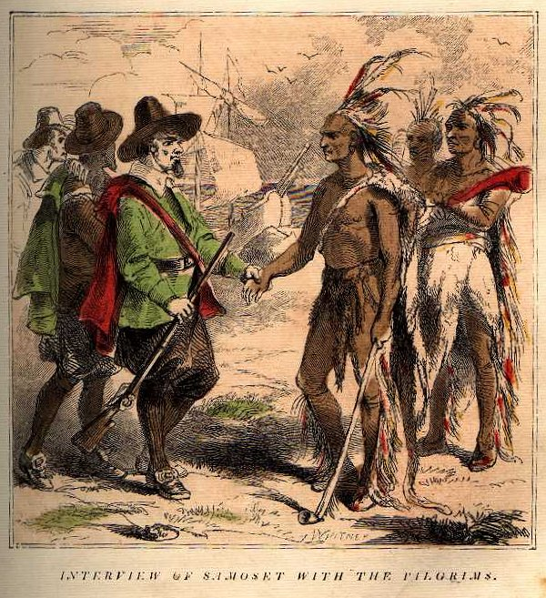
Northern Society (1)
religious groups
Separatists
Puritans
Pilgrims
did NOT depend on slave labor
Roger Williams
believed Natives should be paid for their land
Anne Hutchinson
challenged authority and teachings of the Puritan Church
Notes:
‹#›
Both banished from Mass. Bay Colony, teaching covenant of works instead of grace

Slide 11
Northern Society (2)
town hall meetings
family VERY important
Religious Education
higher standard of living
longer life span
better health
better wages

Slide 12
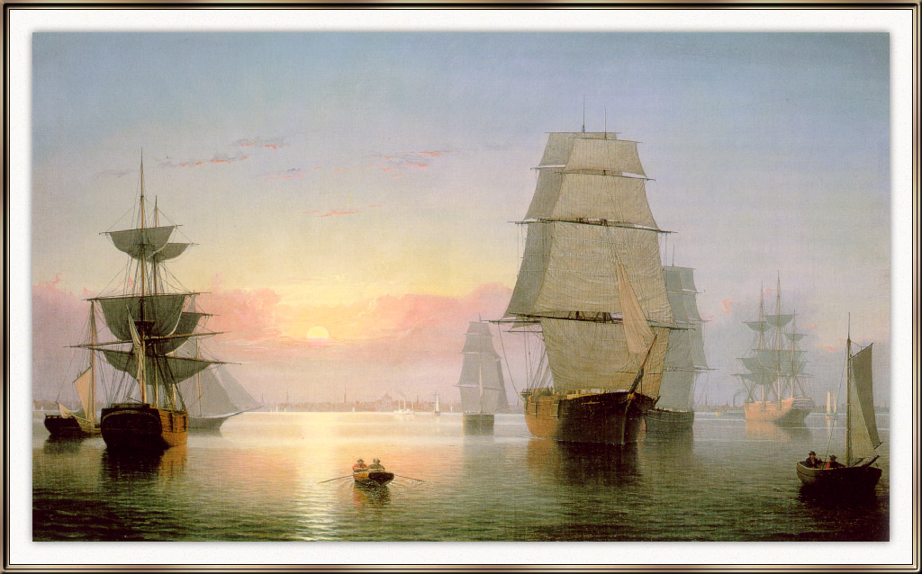
Northern Economy
several port cities
Boston
New Haven
trade
fishing
grinding wheat
lumbering
ship building

Slide 13
Rhode Island
Rhode Island
1644-English government gave Williams a charter
Brought together several settlements into Rhode Island
All people allowed to worship as they pleased
First colony to promote religious freedom
attracted many people
Quakers, Jews

Slide 14
Connecticut & New Hampshire
Connecticut and New Hampshire
Limited amount of good farmland led colonists elsewhere
Minister Thomas Hooker led followers west
set up many settlements
1639-Fundamental Orders of Connecticut
Plan for union of settlements
Basis for documents that would establish rights and responsibilities in the United States
Notes:
expanded the idea of representation

Slide 15
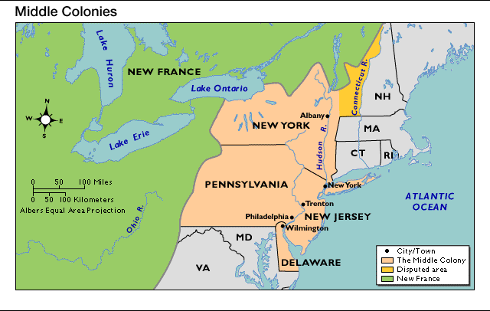
Middle Colonies “Religious Middle Colonies”
1624: New York
1638: Delaware
1660: New Jersey
1643: Pennsylvania

Slide 16
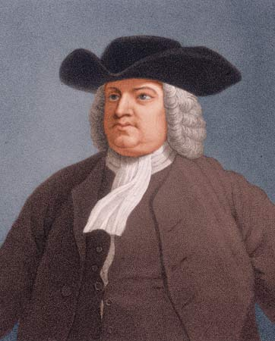
Middle Society
Immigrants
originally Dutch
New York
religious groups
Quakers
William Penn
relatively good relations w/ Natives

Slide 17
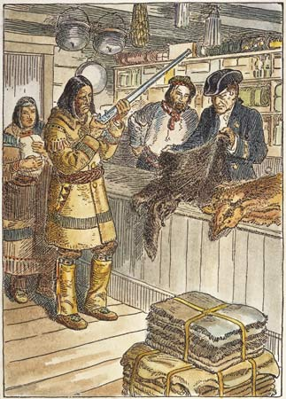
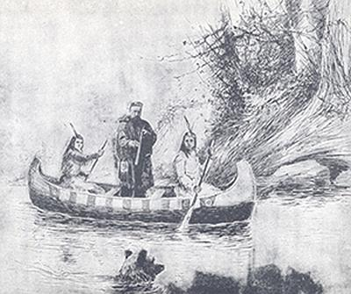
Middle Economy
Wheat crop
fur trading
beavers
some ship building
slave labor
Notes:
‹#›

Slide 18
Pennsylvania
Quakers had a huge following in England
believed in equality and kindness
English leaders considered them dangerous
did not participate in wars
did not join the British army
put in prison and beaten
looked to North America for a safe home
King Charles gave Penn the charter
Notes:
thousands of immigrants came to Penn, irish, scottish, german, french, dutch. They were eager to farm. Penn became the richest colony. Allowed to practice any religion

Slide 19
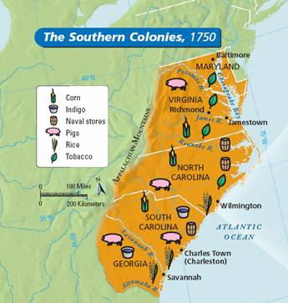
Southern Colonies “Agricultural South”
1607: Virginia
1634: Maryland
1653: North Carolina
1670: South Carolina
1733: Georgia

Slide 20
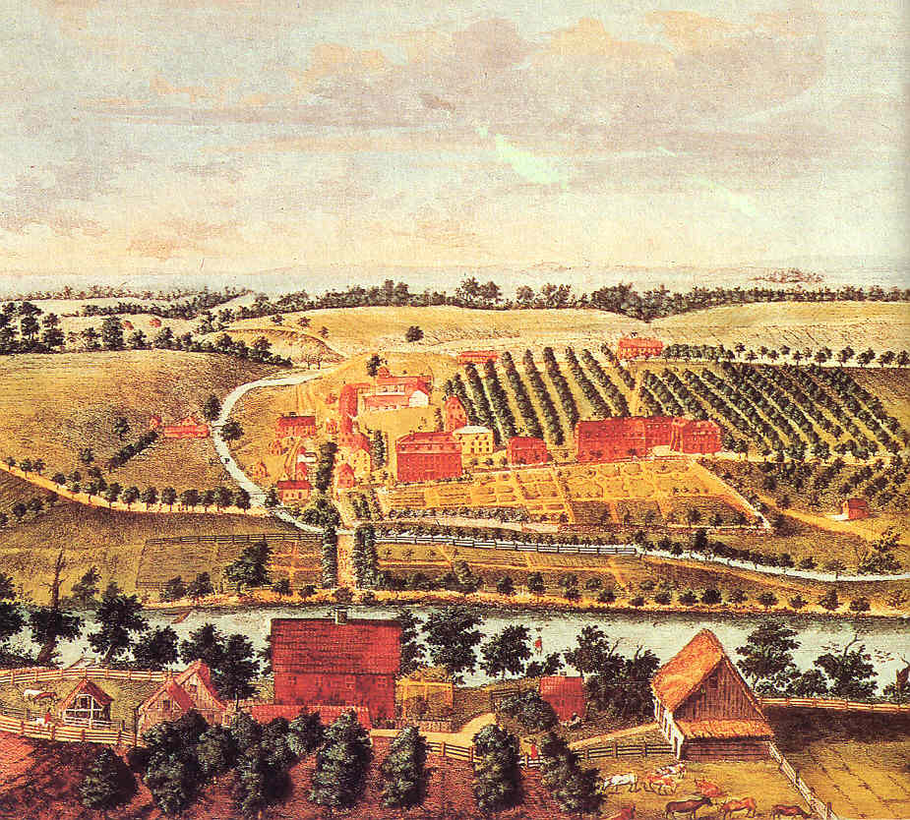
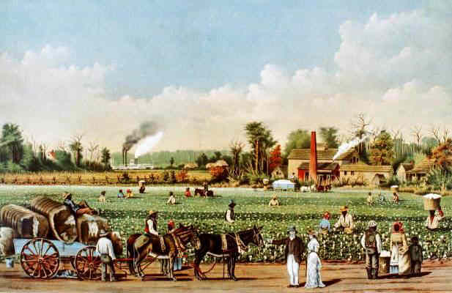
Southern Economy
plantation system
cash crops
indigo (dye/ink)
rice
Tobacco
Notes:
‹#›

Slide 21
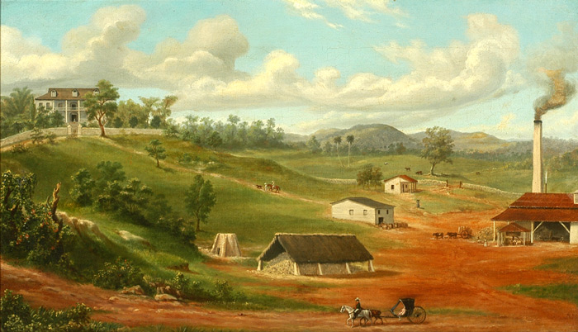
Southern Society (1)
few cities
mostly small farms
controlled by wealthy plantation owners
indentured servants
slaves
lower life expectancy
mostly single, young men
education for wealthy men only
Notes:
‹#›

Slide 22
North & South Carolina
English colonists from West Indies
brought African slaves
first colony to have slaves from the start
tensions between farmers in North & South
led to split between the Carolinas
north wealthy, south poor

Slide 23
Georgia
Last colony to be settled
English debtors
usually imprisoned in England
allowed to colonize Georgia
buffer between England & Spain
Spain colonized Florida

Slide 24
Make it Stick (Left Side Activity)
3-2-1
3 facts from today’s lesson
2 facts that are still unclear
1 thing you are curious about

